Slide 1
Corrective Drills
For Running Mechanics

Slide 2
Why is technique important ?
Increased economy of running
Decreased risk of injury
Much improved performance
Delay the onset of fatigue

Slide 3
What to look at
When looking at running biomechanics, there are many things you can look at:
How the body segments are moving in relation to each other and the ground
Joint angles of the ankle, knee and hips + upper body in each phase of the gait cycle
Stride measurements such as length and cadence
Postural integrity
Notes:
Instead of ONE perfect running technique, there is an acceptable RANGE of running variations. Examples are a running cadence between 160 and 185, rather than ONLY 180; or variations in foot strike patterns since new research shows that heel striking isn’t actually less efficient than midfoot/forefoot strike after all! Only when someone is exhibiting biomechanics that is on the extreme ends of the spectrum, and is obviously inefficient, risking injury or if they are already suffering from injury, then such circumstance calls for an immediate running technique change

Slide 4
Common Faults
Foot | Knee | Hips | Torso | Arms
Running on toes Heavy feet Foot strikes in front of pelvis Excessive pronation | Insufficient flexion - swing thigh Medial collapse upon ground contact | One side drops in stance Forward flexion at all velocities Excessive vertical oscillation | Excessive axial rotation Too much slack | Arms swing across mid-line. Arm swing occurs only at elbow (drummer arm)

Slide 5
Practical
Drill or Exercise | Corrective function
Ankle drop to hip hike in knee drive | One hip drops in stance
Ankling drill | Poor foot strike mechanics (eg: Running on toes) Collapses through ankle complex
Wall slide drill | Excessive rear side mechanics Long swing thigh
Overhead drills | Slack, Excessive axial rotation
Knee drive hammer & Step over drill (SSH) | Lack of postural integrity, collapse or lack of force in foot strike,
Double hops with knee drive | Lack of stiffness, postural integrity, hip flexor strength, hip strength
Stretch calf complex (inadequate dorsi flexion) , Mobilise pelvis for power blockages and stride cycle ROM inefficiencies

Slide 6
Foot Strike
Look For | Faults | Fixes
Dorsi-flexion Mid-foot strike Strike under the hip | Running on toes, Heavy feet, Foot strikes in front of pelvis | Increase length of calf musculature, Increase dorsi flexion ROM, Increase Hip Extensor strength
TECHNICAL TRAINING
Only interaction with ground to transfer force

Slide 7
Foot Recovery
Look For | Faults | Fixes
Quick Recovery Rigid foot Shortening swing thigh | Anterior dominance Negative running Windmilling Long lever | Stretch and or Strengthen Hip Flexors, Strengthen hamstrings, abductors and adductors
TECHNICAL TRAINING
Only interaction with ground to transfer force

Slide 8
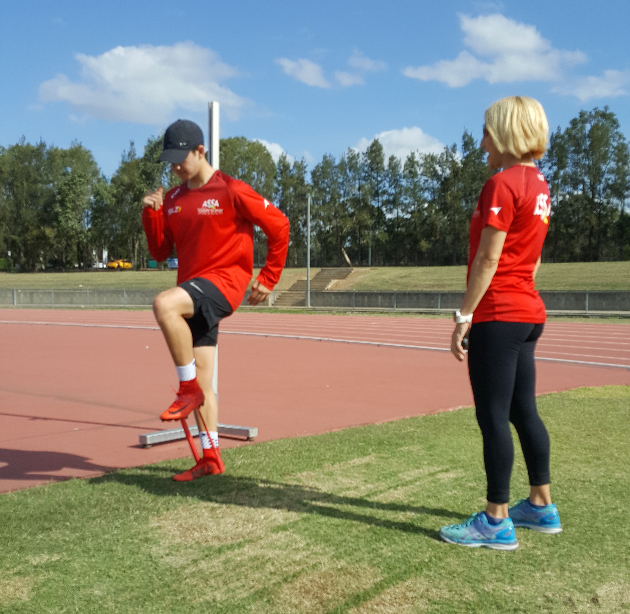
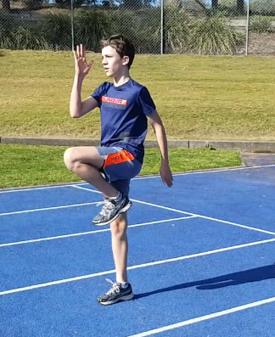
Foot Recovery –
Strengthen Hip Flexors and ensure sufficiency in ROM

Slide 9
Stride Cycle
Look For | Faults | Fixes
Foot returns under hip Short swing thigh Fast anterior knee drive Foot strike under hip Postural Integrity | Hip drops to one side on stance Knee collapse on stance Foot lands in front of hip Postural collapse | Strengthen hip and core musculature Strengthen Glute Med, TFL and abductors Strengthen hip extensors Check ROM sufficiency
TECHNICAL TRAINING
Only interaction with ground to transfer force

Slide 10
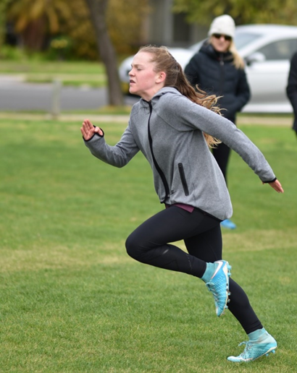
Swing Thigh Velocity
Control of lower limb in technical drills is a critical factor

Slide 11
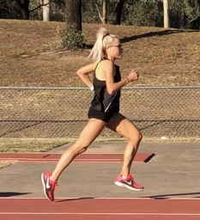
The Running Gait Cycle
Running requires:
Balance
Muscle strength
Sufficiency in joint ROM
Muscle and tendon elasticity
Stiffness
Postural Integrity
Notes:
Balance

Slide 12
Observing Foot strike and postural integrity in common drills

Slide 13
Common Technical
Faults in youth and endurance runners

Slide 14
One Hip Drops in Stance
CAUSE: Weak Hips & Core Musculature
EXERCISES:
Mini Band Lateral walks, Diagonal Steps, Elvis Knees Side Planks with Leg Abduction, Single Leg Box Squats, Ankle drop to knee drive (hip hike).
INJURY ASSOCIATIONS: patellofemoral pain, ITB syndrome, shin pain, stress fractures, plantar fasciitis and Achilles tendinopathy
Notes:
During stance the waistband of a runners shorts should stay parallel to the ground. If it tilts laterally the issue is weak hips

Slide 15
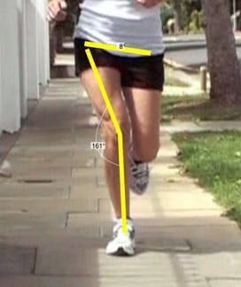
Knee Collapse
CAUSE: Weak hip abductors and external rotators.
EXERCISES: mini band exercises (hip abductors, gluteals and TFL). Single leg step ups, Single leg box squats, Lateral step downs and Lunges.
INJURY ASSOCIATIONS: Runners Knee (patellofemoral pain syndrome), patella tendonitis.
Notes:
Patellofemoral pain syndrome is more common among women.

Slide 16
Secondary cause

Slide 17
Overstriding
CAUSE: Tight hips, weak core, poor technique
EXERCISES: Technical training to keep heel tucked behind swing thigh knee and strike the ground under the hip. Stretch hips (glutes, hamstrings and quads), strengthen complete hip & core musculature.
INJURY ASSOCIATIONS: Achilles bursitis, shin splints, runners knee.

Slide 18
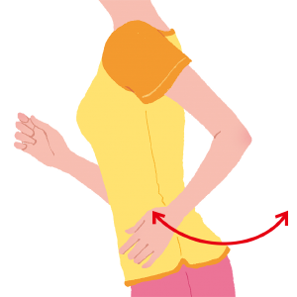
Arm Swing Faults
Arms stay in front of the body, cross the mid-line of the torso and cause unwanted torso rotation….
CAUSES: tight pectoral muscles and lats. Poor postural integrity and back extensor strength
Notes:
This stops your ability to have upright posture and a ‘tall spine’ when running, shortens your stride and decreases your stability.

Slide 19
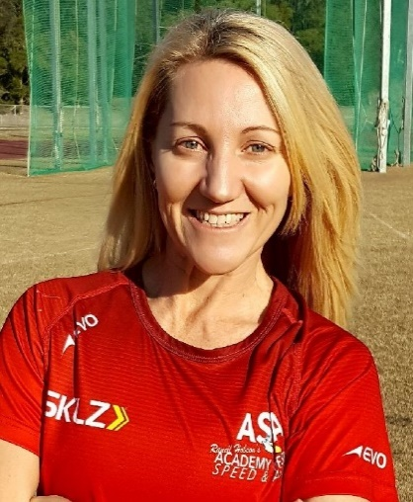
Ranell Hobson
www.academyofsportspeed.com

