Slide 1
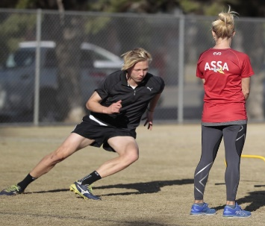
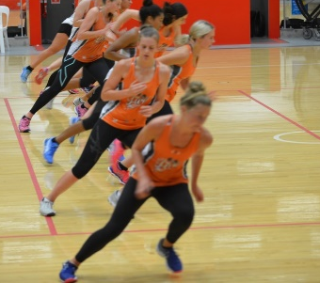
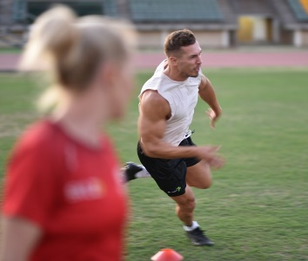
multidirectional speed
COD / MANOEUVRABILITY / AGILITY

Slide 2
Multidirectional speed terminology
CHANGE OF DIRECTION (COD) – technical skill and physical ability to change movement direction, velocity or mode (DeWeese & Nimphius, 2016)
AGILITY – a rapid whole body movement with change of velocity or direction in response to a stimulus (Sheppard & Young, 2006).
MANEUVERABILITY – ‘purpose….to maintain velocity, removing clearly defined ‘plant’ step …. Or to describe a COD when one changes mode of travel’ (Nimphius, 2018)
CHANGE OF DIRECTION SPEED (CODS) – Overarching description of any test that proposes to examine one’s pre-planned COD ability that often has a large component of straight line running (eg: 505, T test, Illinois agility, Pro-agility) (Nimphius et al, 2018)
Notes:
The ability to change initial direction to a predetermined location and space on the field or court is our CODS. However it is the perceptual –cognitive ability to react to a stimulus such a s a defender or the bounce of the ball in addition to the physical ability to change direction that provides a true definition of agility (nimphius, s. 2014)

Slide 3
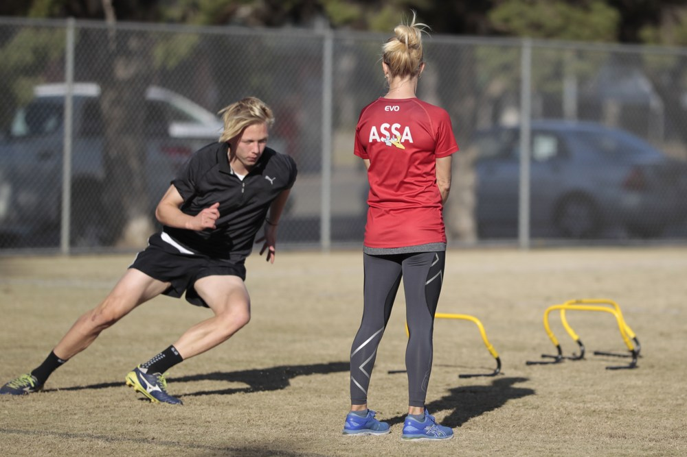
Multidirectional Speed
Cognitive
Situational Experience
Decision Making
Physical
Strength
Conc / Ecc
Technical
COM / BOS
Direction & Magnitude
Mobility & Stability
Notes:
Multi directional Speed has 3 pillars
Cognitive function, which in this context is the ability to read the game, make a decision and act will be highly dependent on time in the game as well as position and situational experience.
Physical readiness implies effective concentric strength for acceleration, eccentric strength for deceleration and braking. Freedom of movement around joint structures and both dynamic and static stability.
Technical development in understanding the Centre of Mass and Base of support relationship in and out of transitions and the use of the inside and outside of the foot to direct force through open hip, crossover step, plants and dodges as an example becomes paramount.

Slide 4
COD & AGILITY
In sport you have to accelerate and then STOP, Change direction, Execute a skill, Make contact with another player etc
Perceptual cognitive – Time it takes to react to a stimulus.
Work on braking (hip, knee and ankle flexion) for both 2 and 1 leg actions.
Work on propulsion in all directions, accelerating forward, sideways, turning, practice getting up from the ground etc.
Once the athlete is proficient at this then add in your technical and tactical aspects – add stimulus – add decision making
Notes:
Athletes need to have the capacity to change course, controlling the direction and position of their body while maintaining momentum. READ first line.
Teach athletes that modifying their relationship to the earth ie: getting low in braking not only allows them to brake in less steps (assuming eccentric strength has been developed) but also puts them in a position to have a very powerful first step out of transition using both elastic and muscular strength.
It’s important to develop these qualities from a variety of positions and in all directions – forward, back wards, sideways, from low positions think about hitting all diagonals possible
Read last line then – it can be as simple as using coloured cones to set up a pre-planned drill which feeds into a reactive drill. An example is using the pro-agility as your standard but then having coloured cones surrounding the pro-agility and once the athlete is approaching the final 5m sprint calling a colour that the athlete has to hit at max speed. You can also add in reactive directional changes and brakes. There is a multitude of drills that you can do in this area, you are only limited by your imagination.

Slide 5
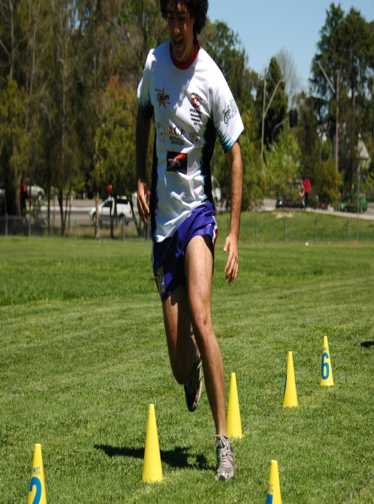
Identifying factors
The ability to start quickly from different positions
Accelerate to top speed in the shortest possible time
Change direction and brake / stop under control
Rapidly react to a stimulus
Photo by Kip Hobson
Notes:
Non contact injuries primarily occur during unexpected lengthening of muscles and ligaments during deceleration and landing
eg: Hamstring in sprinting, ACL tear in landing or cutting.
Turner and Jeffreys in 2010 demonstrated that Plyometrics improves the ability to handle rapid stretch loading.
So for our third point and for decreased risk of injuries, plyometrics and eccentric loading tasks become important in preparatory conditioning.

Slide 6
Those who apply the most FORCE relative to Body Mass and in the right DIRECTION are FASTER ATHLETES
Notes:
There should be a focus in the weight room of developing relative strength against mass, This is where in team sports the debate of how strong is strong enough pops up. Strength needs will be positional and game specific.

Slide 7
Cod mechanics
Get COM low
Shoulders behind hips
Assess 45, 90, 135 & 180
Common Faults
No breaking step
Hip, Knee, Ankle - Collapses in COD
Torso swaying outside of BOS
Puts breaking step in but without force
COD video
Notes:
Agility training requires specific coaching, progression over time, variety within playing context and specific application to the sport and player position.
Your athletes have to be able to stabilise, decelerate and brake, land and take off from a variety of positions - without strength in these actions there is a greater risk of injury. (Hamstrings, adductors, knees and ankles)
Movements to master include – acceleration and deceleration, braking and landing, crossover steps, open hip steps, plants and dodges, drop steps and pivots.

Slide 8
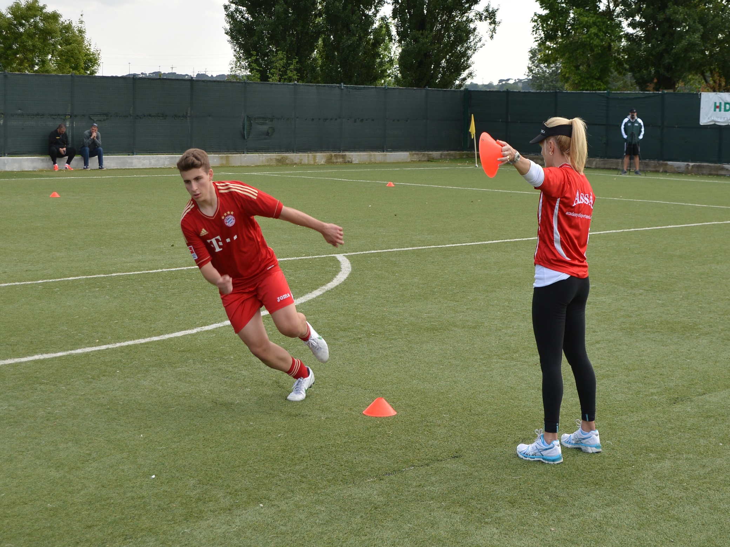
To decrease injury risk, add Reactivity after COD technique has been mastered
Notes:
This just makes sense, the underlying qualities of multi-directional speed include strength, joint mobility, muscle extensibility, postural integrity through a changing base of support and dynamic stability. These physical qualities must be addressed before reactivity training is added.

Slide 9
TRAINING AGILITY
Defensive Agility – Move in the direction I point
Offensive Agility – Move in the opposite direction to which I point
Notes:
Recent research by (Spiteri, Cochrane & Nimphius, 2012) has shown that an athletes lower body response time may differ depending on whether the athlete’s tactical situation is offensive or defensive. The processing strategy which can vary by gender or tactical situation can influence the response time (Spiteri, Cochrane & Nimphius, 2012) speculated that the response to an offensive situation requires information to move across the hemispheres of the brain where as the response to a defensive situation allows processing to occur within one side of the brain. This means for our agility training to be effective

Slide 10
MANEUVERABILITY
effective footwork when tracking or player on player marking
committing speed and footwork to contest a pass
Footwork
Blocking
Dictating
Contesting
footwork response to recover after a challenge or a change in opponents movement
positioning effective angles with sustained footwork to counteract opponent movements

Slide 11
COD Drills / TESTS
5-0-5
Pro-agility
T drill
Illinois Agility
Box drill
RAT (arrow /light/video/
human)
Notes:
These are classic COD and agility drills which are also used as tests.
In the 505 and pro-agility CODS tests, the athlete knows the directional changes to be made, there is no reactivity or decision making required.
These drills allow you to train and assess change of direction mechanics, deceleration, transition or plant step, posture and stability.
The T drill, Illinois and Box drill are manouvreability tests which also allow you to assess tight foot patterning, balance and control and
The Reactive Agility tests allow you to assess all of the above components of multi-directional speed as well as reaction time to a given stimulus.

Slide 12
QUICKNESS

Slide 13
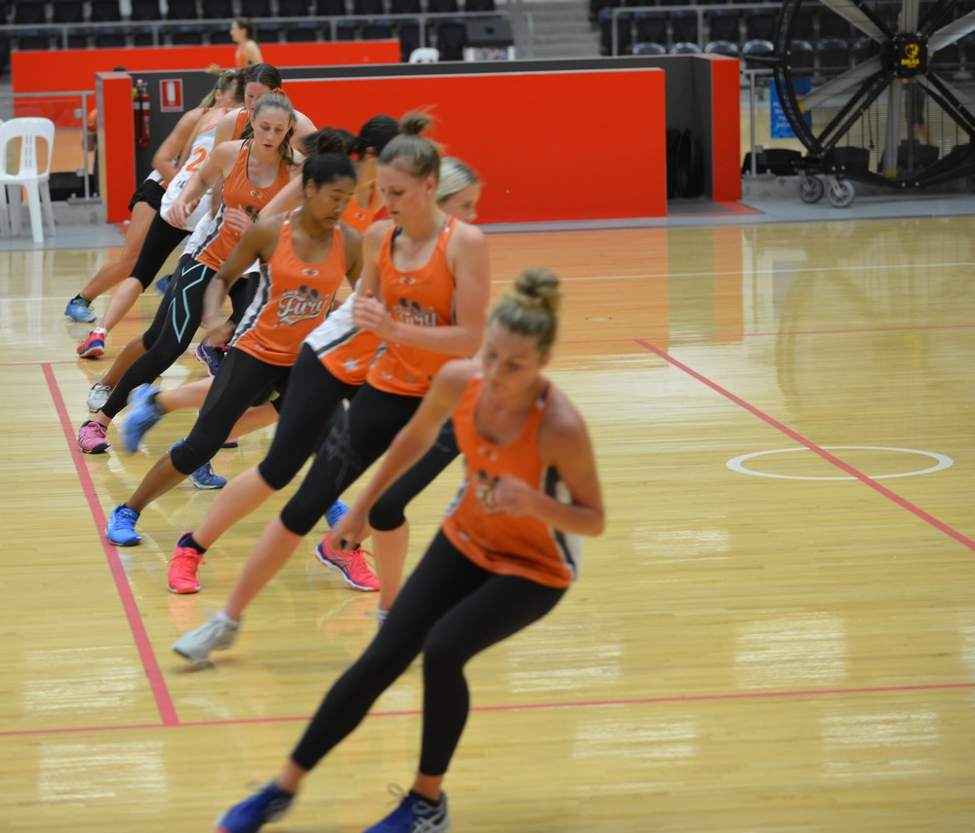
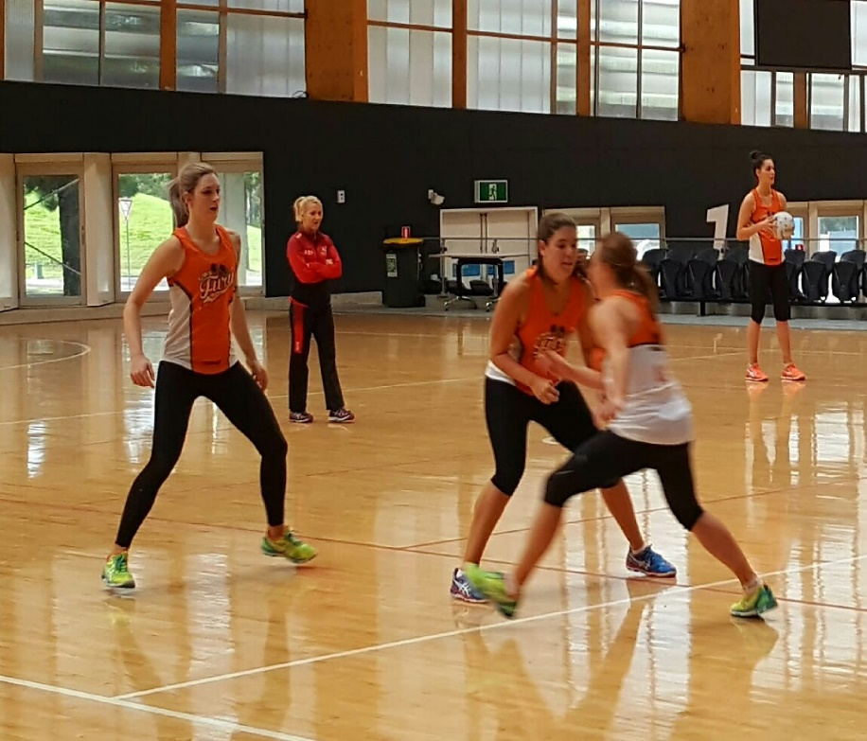
Best practice
Mix competitive game based aspects with opportunities to focus on technical deficiencies.
S&C and Technical coaches working TOGETHER
Notes:
It’s important at this high end of Agility training and development to work with technical coaches to set up game situation drills where athletes are forced to make decisions and act.
The technical coach assess the decision made while you assess the physical and technical qualities of the players, together you identify gaps in player performance and training that may still exist.

Slide 14
Example Session
1 | Game play warm up
2 | Dynamic and Functional warm up
3 | Plyometrics – jumps, hops, bounds (landing technique, 1 & 2 feet in all directions)
4 | Competitive speed work without cueing (observe)
5 | Technical session to work on deficiencies identified in competitive situation
Notes:
This type of session involves you working directly with the technical coaches. The athletes play a small low intensity game for 3 to 5 minutes.
This is followed by a functional and dynamic warm up including some form of interval based cardiovascular effort to increase heart rate and blood flow,
functional movement actions such as squats and lunges to assess ROM of joints and movement quality as well as increasing synovial fluid lubrication of joints. Be sure to add in multidirectional runs and weaves, rhythmical skipping some low intensity jumps and hops.
Then move into jump based training to develop elastic qualities. It may be a simple as introducing landing technique or as complex as multiple hops in various directions to stability hold. Your choices here as always will be dependant on the training age and competency of your athletes.
The next segment is basically getting the players to race each other or engage in chasing games where you can observe from the sideline any technical deficiencies that are present, ensure you are creating scenarios where you are watching the athletes run at varying intensities
Then the goal is to take some time to work on technical clean up – that is run through drills which will correct lever positions or postural integrity that collapsed during the previous segment of training.
The goal is to have technical proficiency in acceleration and top speed that transfers into the game.

Slide 15
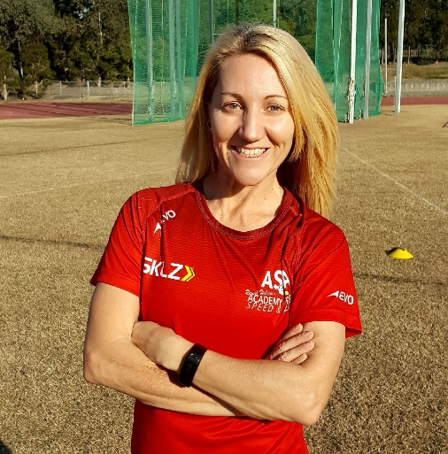
Send your questions to: speedyranell@bigpond.com

