Slide 1
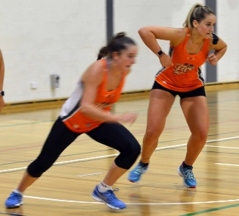
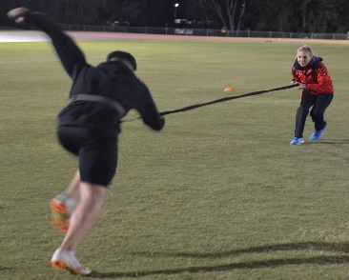
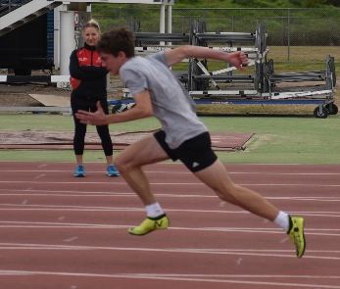
Linear speed
Posture/ Leg action / arm action

Slide 2
Linear Speed Terminology
ACCELERATION – The rate at which a body changes it’s velocity. Sprint performance over small distances.
SPEED – The ability to achieve a high velocity of movement with respect to time. (a manifestation of explosive force)
TOP SPEED/MAX VELOCITY – The highest rate of velocity change with respect to time. The fastest the athlete travels per unit of time over a given distance.
SPEED STRENGTH – Force developed rapidly (RFD) or at high velocities
REPEAT SPRINT ABILITY (RSA) – The ability to sustain high intensity sprints of short duration / distance interspersed with incomplete recoveries, with as little drop off in speed as possible.
Notes:
There is so much terminology surrounding speed that at times it may seem confusing. Here we have some of the most commonly used terms and how they relate to game speed or track speed.
Acceleration (read) – Some players never get out of short acceleration before being required to change direction or be involved in a sport skill. Netball is an example. Basketballers may hit a longer acceleration of 20m down court but it’s not going to be the explosive speeds that we see in track or even in a field sport when a footballer sprints into open space.
Speed is defined as (read) – and Max velocity (Read) but there are not many occasions when a field sport player will be able to hit their maximum velocity in a game situation as we would ask them to do in training. Even if they are sprinting toward a try line, they are focused on evading incoming players, they may have to apply cutting or dodging steps or slightly brake and re-accelerate based on opposing players movements. This doesn’t mean that they won’t hit their max velocity, but how long do they truly maintain it ? Max velocity over distance is truly only seen in the sprint events. This does not mean that we do not train it nor that it is less important than acceleration.
Speed Strength (RFD) - The rate of force development (RFD) is a measure of explosive strength, or simply how fast an athlete can develop force. Athletes with higher rates of force development usually perform better during speed, jumps and some strength tests.
A combination of resistance, ballistic and plyometric training are best used to enhance the RFD in trained athletes, but more of that in my strength for speed course.
improving an athlete’s RFD makes them more explosive as they can develop larger forces in a shorter period of time.
RSA (Read) If a player is not fast in the first place, it’s not useful to see how they repeat their speed. Power endurance, repeat sprint ability, speed endurance, sport-specific conditioning, repeat speed, the terms all mean the same thing, we want our players to be able to sprint when necessary right to the final siren or whistle. BUT a player cannot hold onto speed that he doesn’t have. I discuss RSA in great detail in my Programming for speed course. In this course we look at the important fact that they need to be fast in the first place.
Okay so now that we have looked at the terminology lets break down the pillars of linear speed.

Slide 3
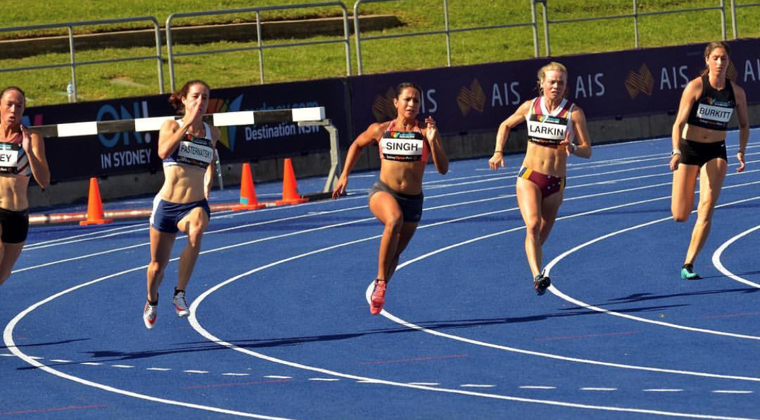
Linear Speed
Technical
Acceleration
Max Velocity
Physical
Strength
RFD/SSC
Mobility / Stability
Notes:
When I develop Linear speed in an athlete, the program is broken down into creating the physical and technical characteristics required for success.
Technical aspects are broken into being able to hit key positions and postures for acceleration, whether that be from the blocks for my sprinters or from a jogging, running, side shuffle, back pedal or any other rolling start.
We then develop transitional positions elements like getting the hips high, maintaining postural integrity, driving the knee up and hammering the foot down through max velocity.
The physical characteristics of max strength, speed strength (Rate of force development creation) are created through resistance training, plyometrics and ballistic training. And of course mobility, stability and postural integrity are critical as well.

Slide 4
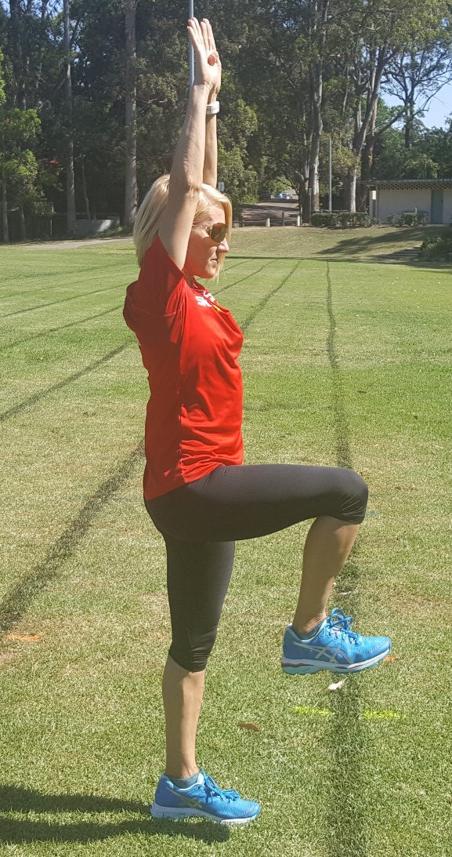
Postural Stabilisation & Alignment
Cornerstone of optimal movement
Stability at the core ensures appropriate movement of the limbs.
Promotes relaxation, freedom of movement and elastic energy production.
Notes:
The movements of the limbs originate from the core of the body, you really need Stability and Postural integrity originating in the torso to get the summation of forces needed for higher speed development.
The stronger the torso the more readily the athlete can maintain top speed for longer durations. There is minimal energy leaks and with that deep strength you delay the onset of fatigue.
Static and dynamic balance as well as stability should be trained, usually within the movement prep and dynamic warm up segments of training and holistically in every speed step taken.

Slide 5
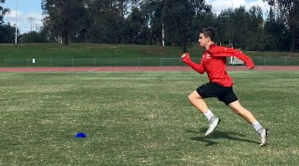
The goal of acceleration
To sustain a balanced posture while optimising the direction and magnitude of force in an effort to reach maximal velocity as fast and efficiently as possible. (Frans Bosch and Ronald Klomp, 2005)
Notes:
Postural integrity allows for a co-ordinated summation of forces to travel through the kinetic chain. The direction and magnitude of force travelling through the foot into the playing surface is determined by skeletal positioning which is why technical or mechanics training is critical.
Acceleration = piston action ; Speed = Cyclic action.
Once an athletes know how to run with efficient mechanics. Technical training falls to the back ground.
If you enjoy the science of running the Bosch and Klomp book is a great read covering all aspects of physiology and biomechanics of running.
Let’s look at Acceleration more deeply.

Slide 6
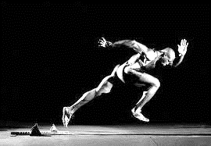
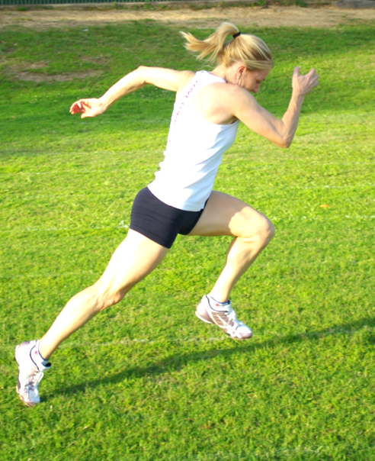
Acceleration
35 – 45’
Faults
Excessive hip flexion
Excessive axial rotation
Dropped head position
Over-reaching first step
45-55’
Notes:
Acceleration as mentioned earlier is The rate of change, of velocity in respect to time. Hence it’s the athletes capacity to generate force which drives acceleration.
The Rate of Force Development (RFD) or the rate of change in force developed over time will dictate changes in velocity that is why it is of utmost importance it’s the foundation of acceleration in Speed.
Common technical faults seen in athletes trying to improve their Acceleratory speed include: (READ)
Over reaching the first step, the dropped head position and not getting out of hip flexion are technical faults that I am correcting on a regular basis. Athletes are cued to stay low which means they bend at the waist.
Their first step they extend the knee and create a brake or upward push rather than getting that horizontal thrust that we need. And the head is looking down to the toes rather than staying neutral with the thoracic spine.

Slide 7
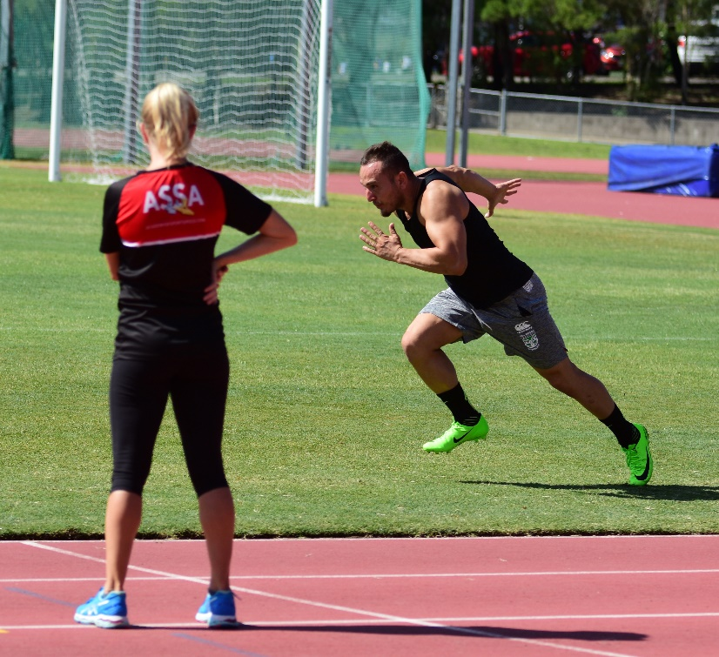
Acceleration cont.
Posture | Straight line from head to heel on stance leg
Ground Contact | Straight back, braced core, ball of foot contact, positive shin contact, shin parallel to rear thigh
Push | Pushing force through foot, driving opposite knee forward, near full extension of hip, knee and ankle
Notes:
There is a perfect balance in Acceleration in driving the knee forward without driving it up, we want to save the upward forces for top speed.
In Acceleration everyone talks about the push of the foot down and back into the ground and Yes that is vitally important BUT we also need to drive or punch the opposing knee forward, just as in top speed there needs to be a synchronised scissor like action of the legs.
Athletes need freedom of movement around the hip joints so that they can have an explosive switch between the triple extension to toe off and the drive and punch of the swing thigh.

Slide 8
Training Acceleration
Wall acceleratory drill
Prone start
Push up start
3 point start
Crouch start
Falling start
Rolling start
Acceleration Drills Video
Notes:
Acceleration means different things to different sports and even playing positions but when developing foundational skills in Acceleration there are some drills that work for all.
Let’s look at the videos of these acceleration drills. In this video you will see the equipment free acceleration drills. In the strength for speed course we will look at resisted acceleration such as the use of sleds, prowlers, resisted accelerator mechanisms and wearable resistance.

Slide 9
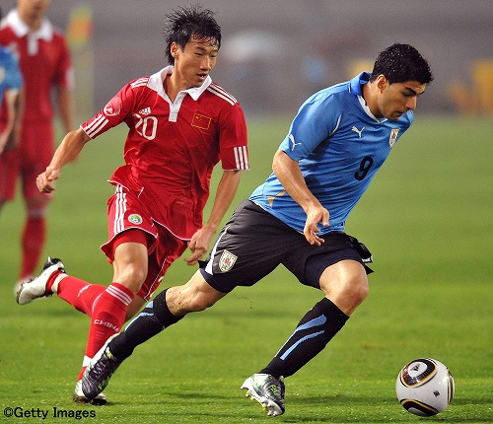
CONTEXTUAL INTERFERENCE
After a period of block training, integrate contextual interference into the Acceleration training for greater skill acquisition and game transfer
Notes:
Contextual interference means that you get the athlete to practice the skill of acceleration within the concept of other tasks in practice.
An example may be accelerating onto a pass, Accelerating after landing from a jump, Accelerating against an opponent to get to the ball, make a passing shot etc.
This allows transfer of the skill into competitive situations.
Keep in mind the foundation of acceleratory speed is strength, so that needs to be looked after somewhere else in your programming.

Slide 10
Notes:
What this is saying is that Strength, both speed strength and relative strength are critical to acceleration and in short acceleration court games such as Netball and Basketball, horizontal propulsion for acceleration capabilities is critical.
Exercises such as prowler pushes, sled pulls etc are important to include in programming.
You also need to be mindful of driving into toe off in strength lifts. Squats, Deadlifts etc are all performed on a flat foot.
However if you start to implement pulling derivatives of Olympic Lifts such as high pulls, hang high pulls, jump shrugs etc then you are developing strength through hip, knee and ankle extension.

Slide 11
MAX VELOCITY
Constraints exist across sports when it comes to hitting top speed but everyone wants to cover as much ground as possible in the shortest possible time.
Notes:
Look at Usain Bolt’s sprint mechanics here. The higher the hips, knee and foot ready to hammer the ground and create vertical force, this acts against gravity and delivers a bigger stride length.
During flight in top speed, gravity is pushing you back to earth, so the athlete needs to overcome those forces by creating their own vertical forces via the hammer strike of the foot. Let’s look at this more closely

Slide 12
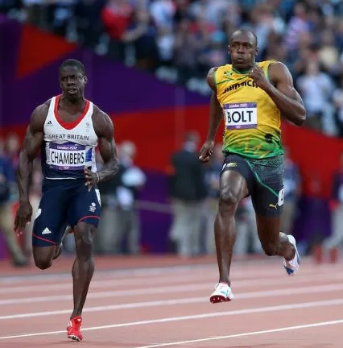
All great sprinters produce lots of vertical force and spend very little time on the ground.
Notes:
sprinters must generate a vertical force of up to five times their body weight to overcome gravitational forces
Newton’s second law of physics states that force equals mass x acceleration
In sprinting, the body (the mass) goes through upward acceleration during each foot contact.
Since there is a large downward gravitational force pulling the body down an enormous force must be pushed into the ground.
This force is generated by triple extension of the hip, knee, and ankle.
The force of the leg needs to stop the fall, hold the body upright and launch the body back into flight
Lets have a look at what we should be observing in Top Speed.

Slide 13
Top Speed / Max Velocity
Posture | Trunk erect, Head Level, Hips tall
Ground Contact | Upright posture, Minimise horizontal distance between foot and hips, legs together, heel high
Stance | Upright posture, tall hips, vertical force, swing thigh active and in front of stance leg. Step up and over. Swing leg unfolds
Toe Off | Projection of non-support hip, high knee drive, neutral or dorsi flexed ankle, minimal backside mechanics
Flight | Vertical displacement, downward acceleration of thigh, neutral or dorsiflexed ankle
Notes:
This slide outlines what we want to see at each point of the stride cycle, this is going to be best assessed by using kinograms and slow motion video footage.
An experienced eye will be able to assess positions and postures at speed and provide corrective feedback on the fly.
Lets look at a

Slide 14
KINOGRAMS
Stuart McMillan
& Dan Pfaff, 2017
Notes:
Kinograms are pictorial representations of phases of a skill and are used extensively in skill development, The skill of sprinting is no different. This upper picture in this slide compares left and right side mechanics at Toe off, Max vertical propulsion, foot strike which is when the hamstring is loaded eccentrically, touch down when the foot first makes contact with the ground, then full support as the foot is directly underneath the hip. Collectively the complete stride cycle is represented. These days all coaches can use their smart phones to record and break down patterns of movement from rep to rep or session to session with ease. Just be sure you do not get caught in the trap of paralysis by analysis. Give your athletes time to explore their stride and experiment with how the stride feels. Coaching cues should be directed externally towards an outcome rather than towards an internal joint action.

Slide 15
Foot strike mechanics
Acceleratory position
Mid to forefoot strike
Apply force backward
Only interaction with the ground
Common Faults
Running on toes
Heavy feet
Foot strike in front of hips
Foot strike video
Notes:
The foot strike is the only interaction with the ground to cause linear or lateral movement. Horizontal or vertical propulsion.
If you run on your toes then when you strike the ground, you have already contracted your gastrocnemius and can no longer use it to drive you forward and off the ground.
This leads to a dramatically decreased horizontal propulsion
Coaches should think “no toes, no heels”.
Newtons law of physics – to every action, there is an equal and opposite reaction
Contact time will be dependant on the strength of the athlete a combination of muscular stiffness and elasticity

Slide 16
impulse
A term for the ‘foot- ground contact’ created by each step and the numeric value defined as:
force x time
Each impulse has a direction and a magnitude. Direction is the mix of horizontal and vertical propulsion. Magnitude is the measure of force.
Notes:
Getting the Foot strike right dramatically influences the success of an athlete or team.
When correctly performed for either linear or COD speed it can decrease risk of injuries (incl: severs and oschgood schlatters in growing athletes).
Increase energy efficiency and overall explosiveness. When the foot lands too far in front of the hips, it creates a breaking force which athletes must then overcome in each step creating large fuel inefficiency and bringing forward the onset of fatigue.

Slide 17
Foot recovery mechanics
Teaches quick recovery of the foot up and off the ground
Teaches the leg to take the shortest path to the front of the body
Quick excitation of hamstring
Common Faults
Anterior dominance
Excessive time in recovery (negative running) phase
Windmilling
Foot Recovery video
Notes:
Frans Bosch in his thoughts on Positive running, discusses that at the moment of ‘toe off’ (from the stance leg) there is an imp. transition in muscle activity from the posterior chain (hamstring, glute, erector spinae) to the anterior chain (iliopsoas and rectus abdominus) this transfer is in the form of elastic energy.
The kinetic chain and fascial lines are Loaded in an elongated position to rebound concentrically like a rubber band stretched over a sling shot.
Coach athletes to keep the pelvis from going too far into anterior pelvic tilt and refrain from pelvic rotation.
Coach athletes to keep the knee from travelling too far behind the hip before quick excitation and return to a positive position.

Slide 18
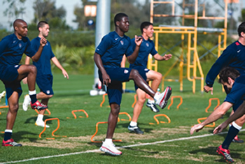
Pawing is an illusion from rapid hip extension
??- B skips - ??
Too much action at the knee decreases the velocity of the hip which is the prime generator of force.
The closer the heel is to the hip axis, the greater the angular acceleration in the swing thigh
Notes:
The ASSA wall slide drill – the closer the heel is to the hip axis, the greater the angular acceleration there is in the thigh.

Slide 19
Stride cycle mechanics
High hip position
Punch the knee
COM high
Short lever
Common Faults
Sitting low in the hips
Shuffling (no knee lift)
Windmilling
Notes:
Many runners remain passive during the float phase (when both feet are off the ground), they attempt to develop tension and power once they have landed and are in the support phase. Sprinting fast is what you do when you are released from the ground, the switch of the thighs, the dorsi flexion of the lower limb readying pre-tension to strike the ground are examples. The energy from the scissor or switch action not only brings the swing thigh to the front quickly but also increases horizontal thrust.
The ASSA step over drill – the faster the thigh moves forward the more force is applied to the ground by the support or stance leg.

Slide 20
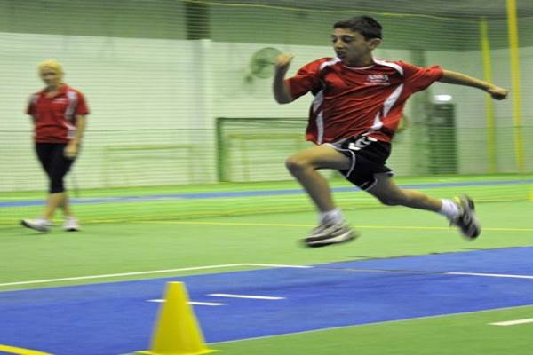
Stride time
The time taken to complete one stride (full cycle)
Stride time = stride speed x angular velocity
Stride speed – physiological
Angular velocity - biomechanical
Notes:
Physiology = muscle fibre type, muscle flexibility, strength & neuromuscular co-ordination
Biomechanical = the path the leg takes – creating speed thru mechanical advantage

Slide 21
STRIDE LENGTH
HIP MOBILITY
GLUTE STRENGTH
D&M FOOTSTRIKE
Notes:
Stride length is dependant on the extensibility of musculature and freedom of movement around joint structures particularly the hip and ankle
Glute strength is of prime importance due to it’s contribution to horizontal thrust
And the direction and magnitude of force that is applied at foot strike will determine the vertical and horizontal propulsion result and thus stride length.

Slide 22
Training max velocity
Modes:
Flying sprints
Variable speed sprints (SSS)
Short speed endurance
Long speed endurance (track only)
Distance:
10 – 40m (field sports) – up to 60m (large field AFL)
Large variations for track athletes 50m to 120m
Rest:
30 – 60 sec per 10m

Slide 23
Illusion of speed
Stressing stride frequency without developing strength
An athlete must have proper force application
“frequency of leg turn over does not cause linear motion, applying force to the ground does”
Avoiding full ROM sacrifices force application
Notes:
An athletes legs can turn over rapidly and they ‘look’ fast.
If there is not significant glute strength the athlete just moves up and down. There is a huge amount or energy loss and the athlete brings forward the onset of fatigue.
We can see how mobility, strength and power, elastic qualities and technique all must be developed to develop great speed.

Slide 24
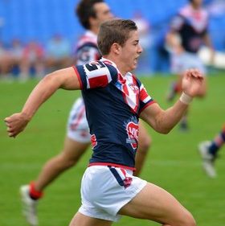
Arm action
90’ at elbow and shoulder
First few steps in acceleratory position can be whipping action
Common Faults
Swings across midline of body
Too high
Too low
Drummer boy
Notes:
Pre – stretch in pectoral group allows for effective recoil so emphasis should always be on driving elbow back, not punching arm forward.

Slide 25
Technical drills
Use to reinforce correct patterns of movement
Change incorrect patterns
Choose a few drills that are specific to the problem
Complete pre-conditioning (fresh nervous system)
Not a replacement for actual sprinting
Max Velocity Technical drill progressions
Notes:
We will cover the specific technical drills required for speed in our mechanics in speed for explosive force lecture.
For time poor coaches / athletes – a few well chosen drills placed in the dynamic warm up will continually reinforce good mechanics.
Beginners will need more block practice – they need time to figure out how to perform the drills correctly, like any new skill.

Slide 26
Why top speed for field sport ?
Increased acceleratory speed
Reduced probability of overuse injuries to joints, tendons and ligaments
Increased elasticity of feet and lower legs for speed and agility
Exposure to high magnitude of central and peripheral stressors for optimal adaptation
Specific adaptation, co-ordination and synchronisation of flexors, extensors and stabilizers
Notes:
Besides getting faster there are a number of benefits for team sport athletes in performing max velocity sprints in training.
Sprinting at max velocity is a true plyometric activity and thus it increases tendon elasticity
By increasing an athletes maximal output through top speed training, all sub-maximal outputs underneath that become faster and become easier on the body. This is know as speed reserve.
When your top speed increases, so does your speed reserve.
what once represented 80% of your athletes top speed might now represent 70%. What happens is that the energy demands to achieve and maintain that speed are significantly reduced.
Not only does a higher max speed improve conditioning, but it improves acceleration, too
Obviously you have to accelerate to reach top speed, but acceleration plus max speed training results in superior acceleration improvements compared to acceleration training alone.
If you want to move faster over any distance, a higher max speed is very beneficial
Heart rates also recover faster between any work efforts . Remember to program max velocity for the end of the training week, so that the nervous system fatigue does not interfere with strength, speed or power development.

Slide 27
Faude, Koch & Meyer (2012)
Journal of Sports Sciences
Straight sprinting is the most frequent action in goal situations in professional football
Research was conducted in the first German National League in the 2007/08 season.
360 goals were analysed
Most actions of the scoring player were straight sprints
Without an opponent
Without the ball

Slide 28
Send your questions to: speedyranell@bigpond.com

