Slide 1
HOW to MAXIMISE YOUR ATHLETIC PERFORMANCE

Slide 2
A 4 POINT APPROACH
1. Address any high risk imbalances / irregularities that could lead to injury
Learn correct Speed, COD and Lifting technique to maximise athletic
potential
3. Develop Elastic strength and Explosive power
4. Use mobilisation techniques for tissue integrity, recovery & regeneration

Slide 3
WHY is TECHNIQUE So Important ?
If you train fitness without function you reinforce compensatory actions that lead to micro-trauma, fatigue and possible injury.
Inefficient running mechanics reduces time to fatigue.
The onset of fatigue brings with it errors in decision making; errors in skill application and an inability to perform at 100%.

Slide 4
IT STARTS WITH THE WARM UP
Attention to detail in positions and postures of ALL drills and EXERCISES moves you forward in leaps and bounds

Slide 5
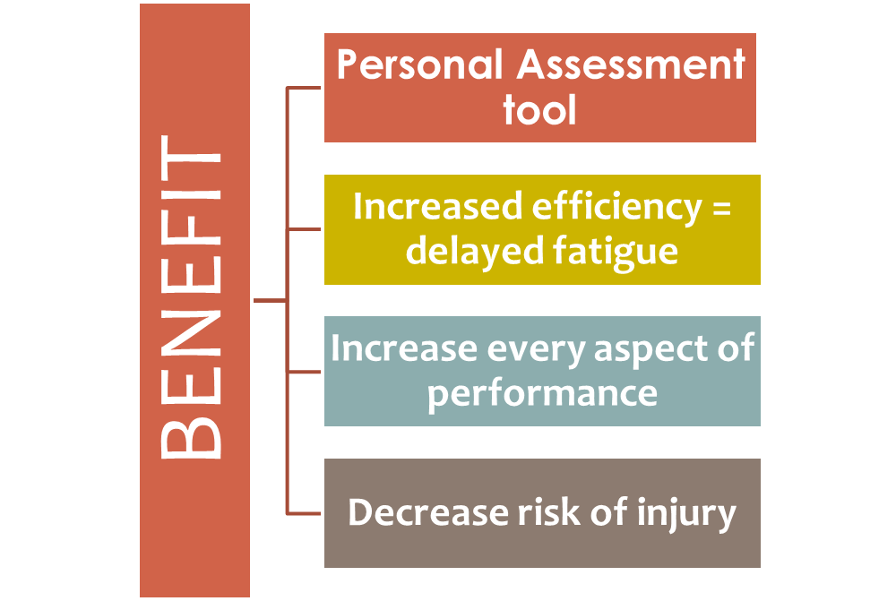

Slide 6
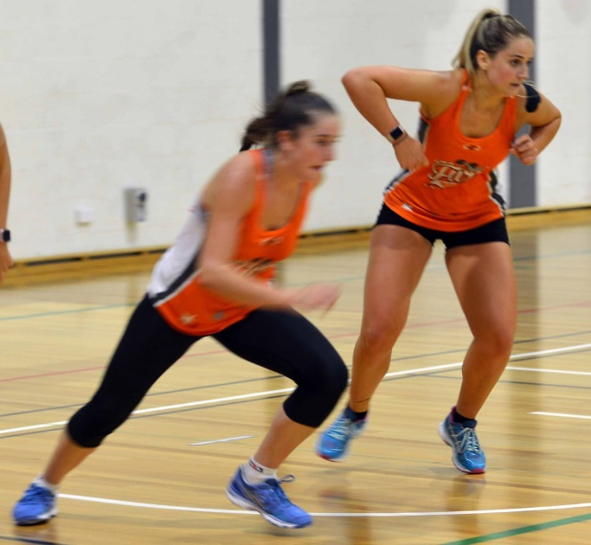
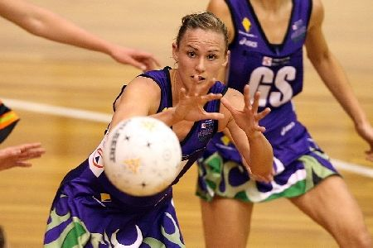
Which Player Are YOU ?
Athleticism Cannot be understated
Critically important in determining representative (selection) status for players
Fast mover + Fast Thinker | Fast Mover + Slow Thinker
Slow mover + Fast Thinker | Slow mover + Slow Thinker
Notes:
Acceleration requires max motor unit recruitment – synchronised both intra and inter musculature co-ordination

Slide 7
“Participation alone in
Training and Games WILL NOT result in maximal improvement in
speed, nor will it build strength, power or injury resilience.”
You need to make time for Specific training in Athletic components.

Slide 8
Foundations to Optimal Performance
Physical Competencies as a Foundation
Mobility - ROM at given joints
Stability - Control in both static and dynamic actions
Training under load - endurance / strength / speed / power / agility

Slide 9
Speed, Change of Direction & Agility
SPEED
Acceleration, capacity to create force
Distance / Time
AGILITY
Perceptual cognitive ability to read a situation, make a decision and react
COD
Physical capacity to decelerate brake, CD and accelerate again
Notes:
Acceleration = capacity to develop explosive force, we will discuss in future presentations the difference in training these two very different skills.
The main difference between high level and low level athletes is not the obvious ie: bigger, faster, stronger etc It is their ability to make a snap judgement and react ie: REACTIVE AGILITY

Slide 10
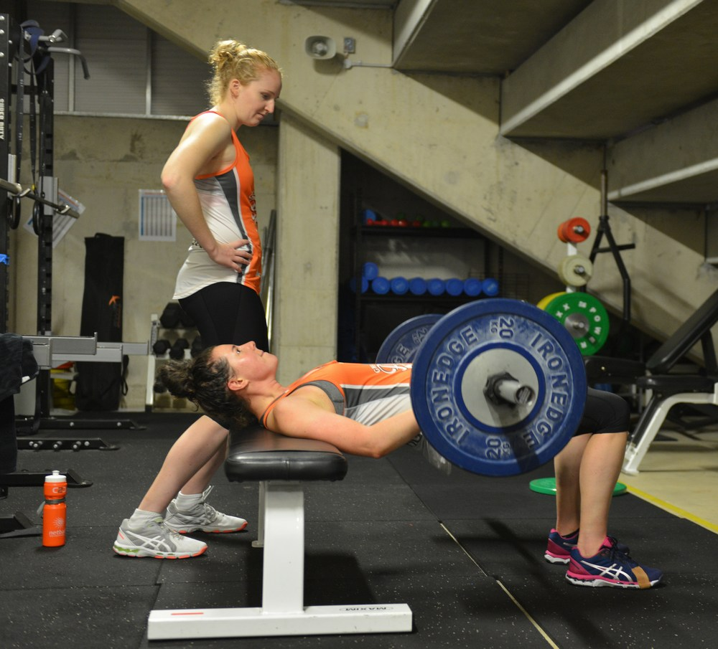
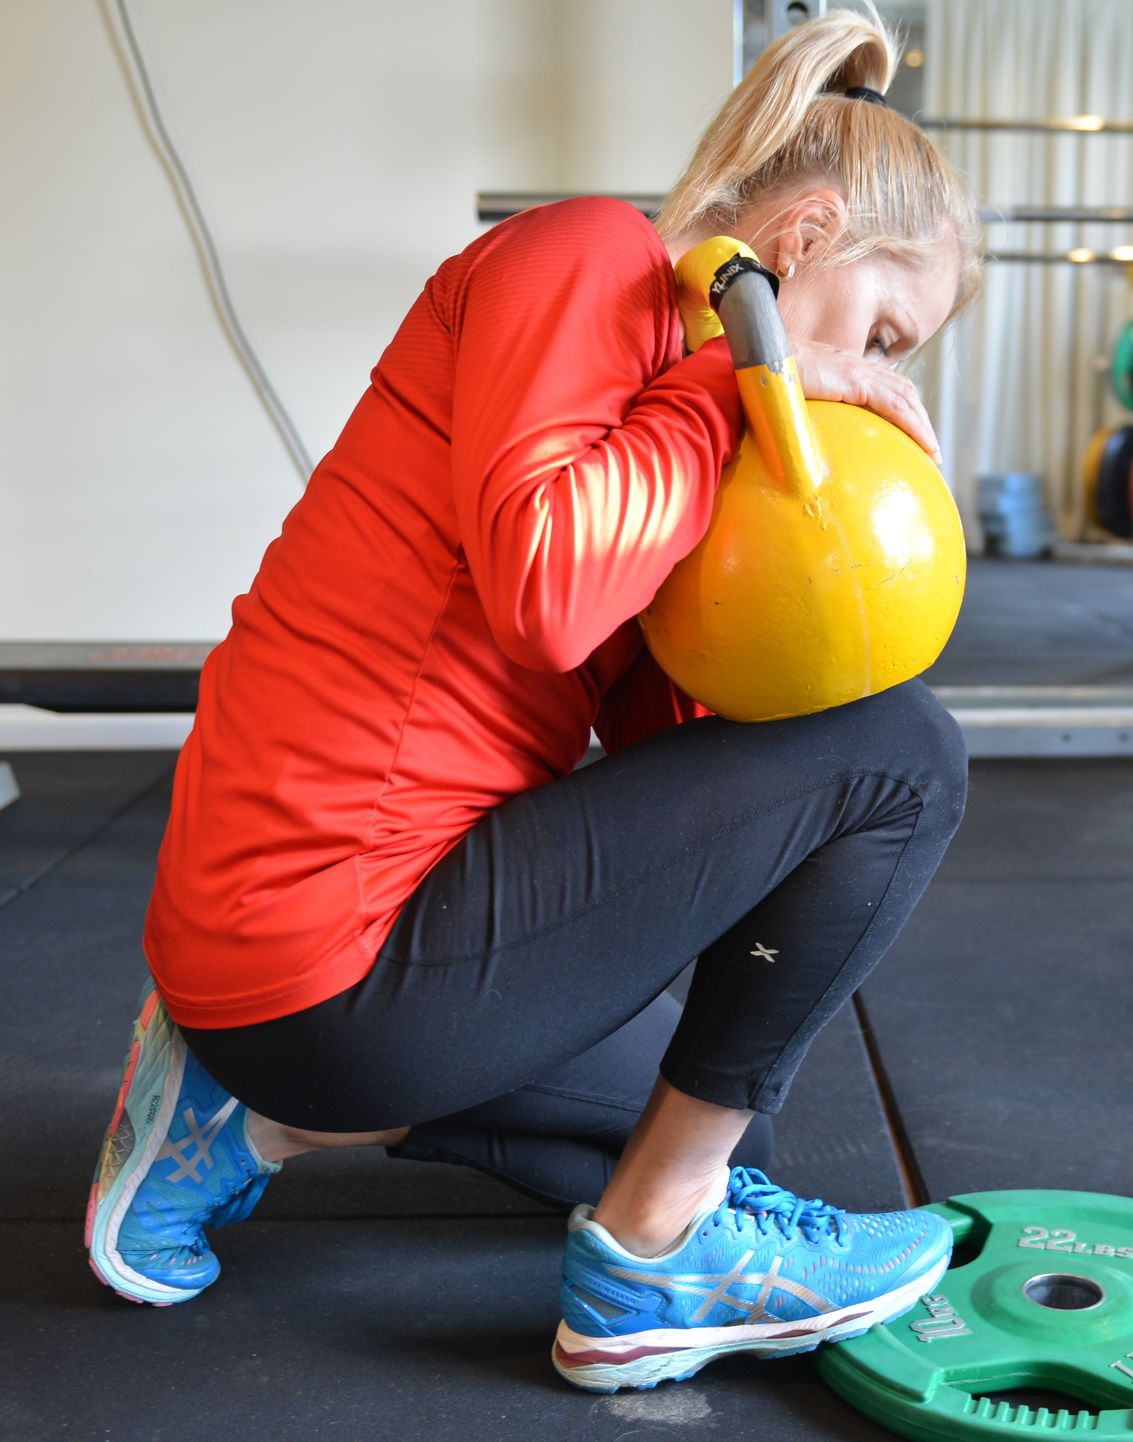
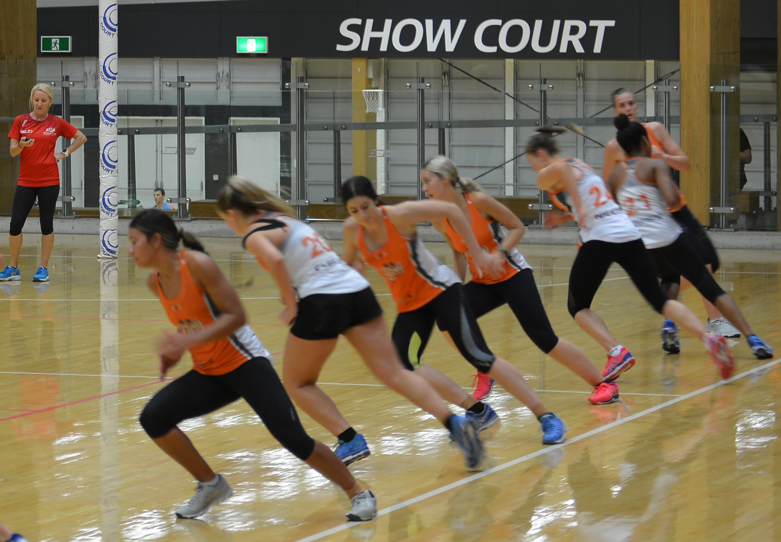
What you need for Speed
Efficient mechanics – no leaks in force or energy
Max Strength – the ability to create force
Power – fast excitation (rate of force development / SSC)
Mobility & Flexibility – ROM & Elasticity
Notes:
Mechanics – If you run without technique you get TIRED really quickly. Good technique is governed by kinesiology, biomechanics and the laws of physics.
AND if you just practice drills all the time you just get better at drills – APPLICATION is the key.
Don’t forget MOBILITY, which is different to flexibility ie: ROM in joint structure. Stride length is all about Hip Joint Mobility (and glute strength in terms of horizontal propulsion)

Slide 11
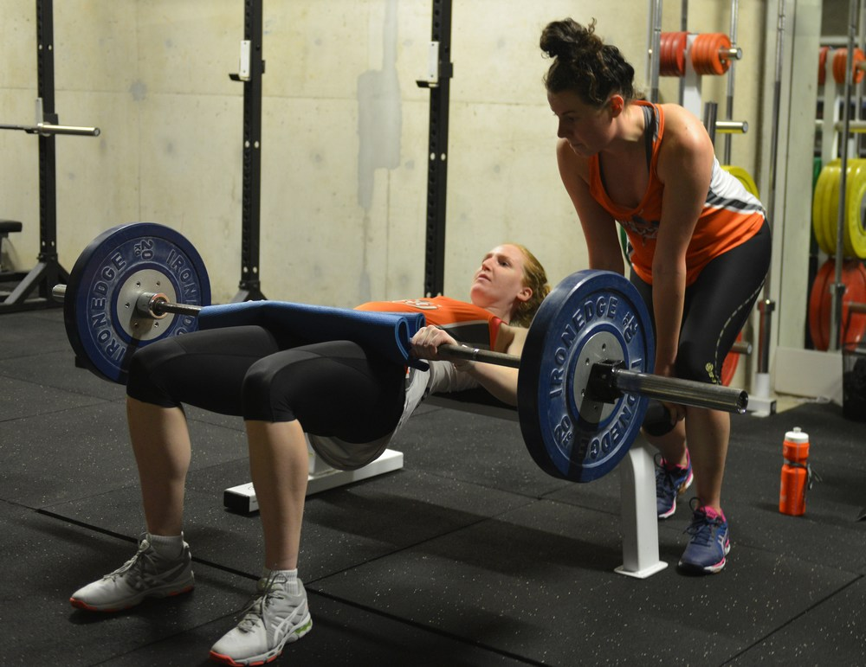
STRENGTH causes motion
Speed is a measurement of Motion
Speed is a measurement of motion

Slide 12
Functional Athletic Movements
Squat
Lunge
Hinge
Push
Press
Pull

Slide 13
Joint Mobility and Muscle Flexibility
Decreases energy used in specific sporting actions
Prevents strain and pain around knees, ankles, shoulders
Plantar and dorsiflexion should be a major concern for all athletes.
Good flexibility prevents stress injuries.

Slide 14
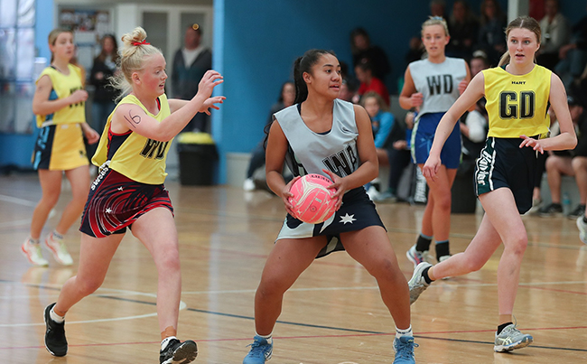
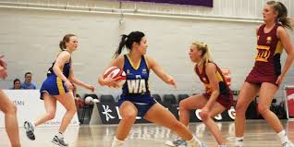
Court Specific
The ability to start quickly from different positions
Accelerate to top speed in the shortest possible time
Change direction and brake / stop under control
Rapidly react to a stimulus
Notes:
Non contact injuries primarily occur during unexpected lengthening of muscles and ligaments during deceleration and landing
eg: Hamstring in sprinting, ACL tear in landing or cutting.
Turner and Jeffreys in 2010 demonstrated that Plyometrics improves the ability to handle rapid stretch loading.
So for our third point and for decreased risk of injuries, plyometrics and eccentric loading tasks become important in preparatory conditioning.

Slide 15
Biomechanics
ACCELERATION
STRIDE CYCLE
DECELERATION / COD
Postural Integrity
Short Acceleration
Maximum Acceleration
Foot Strike
Foot Recovery
Stride Cycle
Deceleration & Braking
Change of Direction
Manoeuvring

Slide 16
ACCELERATION
Technique:
Positive shin, dorsiflexed foot
Cue: Knee drives toward target
Cue: Push down and back
Postural Integrity
Magnitude of Force

Slide 17
Technique –
Foot strike
LOOK FOR:
Dorsi-flexion
Mid-foot strike
Strike under the hip
Common faults
Running on toes
Heavy feet
Foot strikes in front of pelvis
Only interaction with court to transfer force

Slide 18
Technique –
Foot Recovery
LOOK FOR:
Quick Recovery
Rigid foot
Short lever
Common faults
Anterior dominance
Negative running
Windmilling
Long levers
Fuel Efficiency & Kinetic Chain Factors

Slide 19
Technique –
Stride Cycle
LOOK FOR:
Hip Position
Knee driving fwd
High COM
Strong Downward Strike
Common faults
Sitting low (COM)
Shuffling
Up and Down Movements
Little Force
Stride time = stride speed x angular velocity

Slide 20
Technique –
Decelerating
LOOK FOR:
COM low
Shorter steps
Shoulders behind hips
Postural control
Common faults
Lack of Eccentric Control
Lack of Postural Integrity

Slide 21
Maneuverability
effective footwork when tracking or player on player marking
committing speed and footwork to contest a pass
Footwork
Blocking
Dictating
Contesting
footwork response to recover after a challenge or a change in opponents movement
positioning effective angles with sustained footwork to counteract opponent movements

Slide 22
Quick word on agility
Rapid whole body movement with change of velocity or direction in response to a stimulus. Includes sub-components: reaction time; acceleration; deceleration & COD”. (Sheppard et al, 2014).
Cognitive
Reactive ability
Decision making
Physical
Strength
Stability
Mobility
Biomechanical
Technique

Slide 23
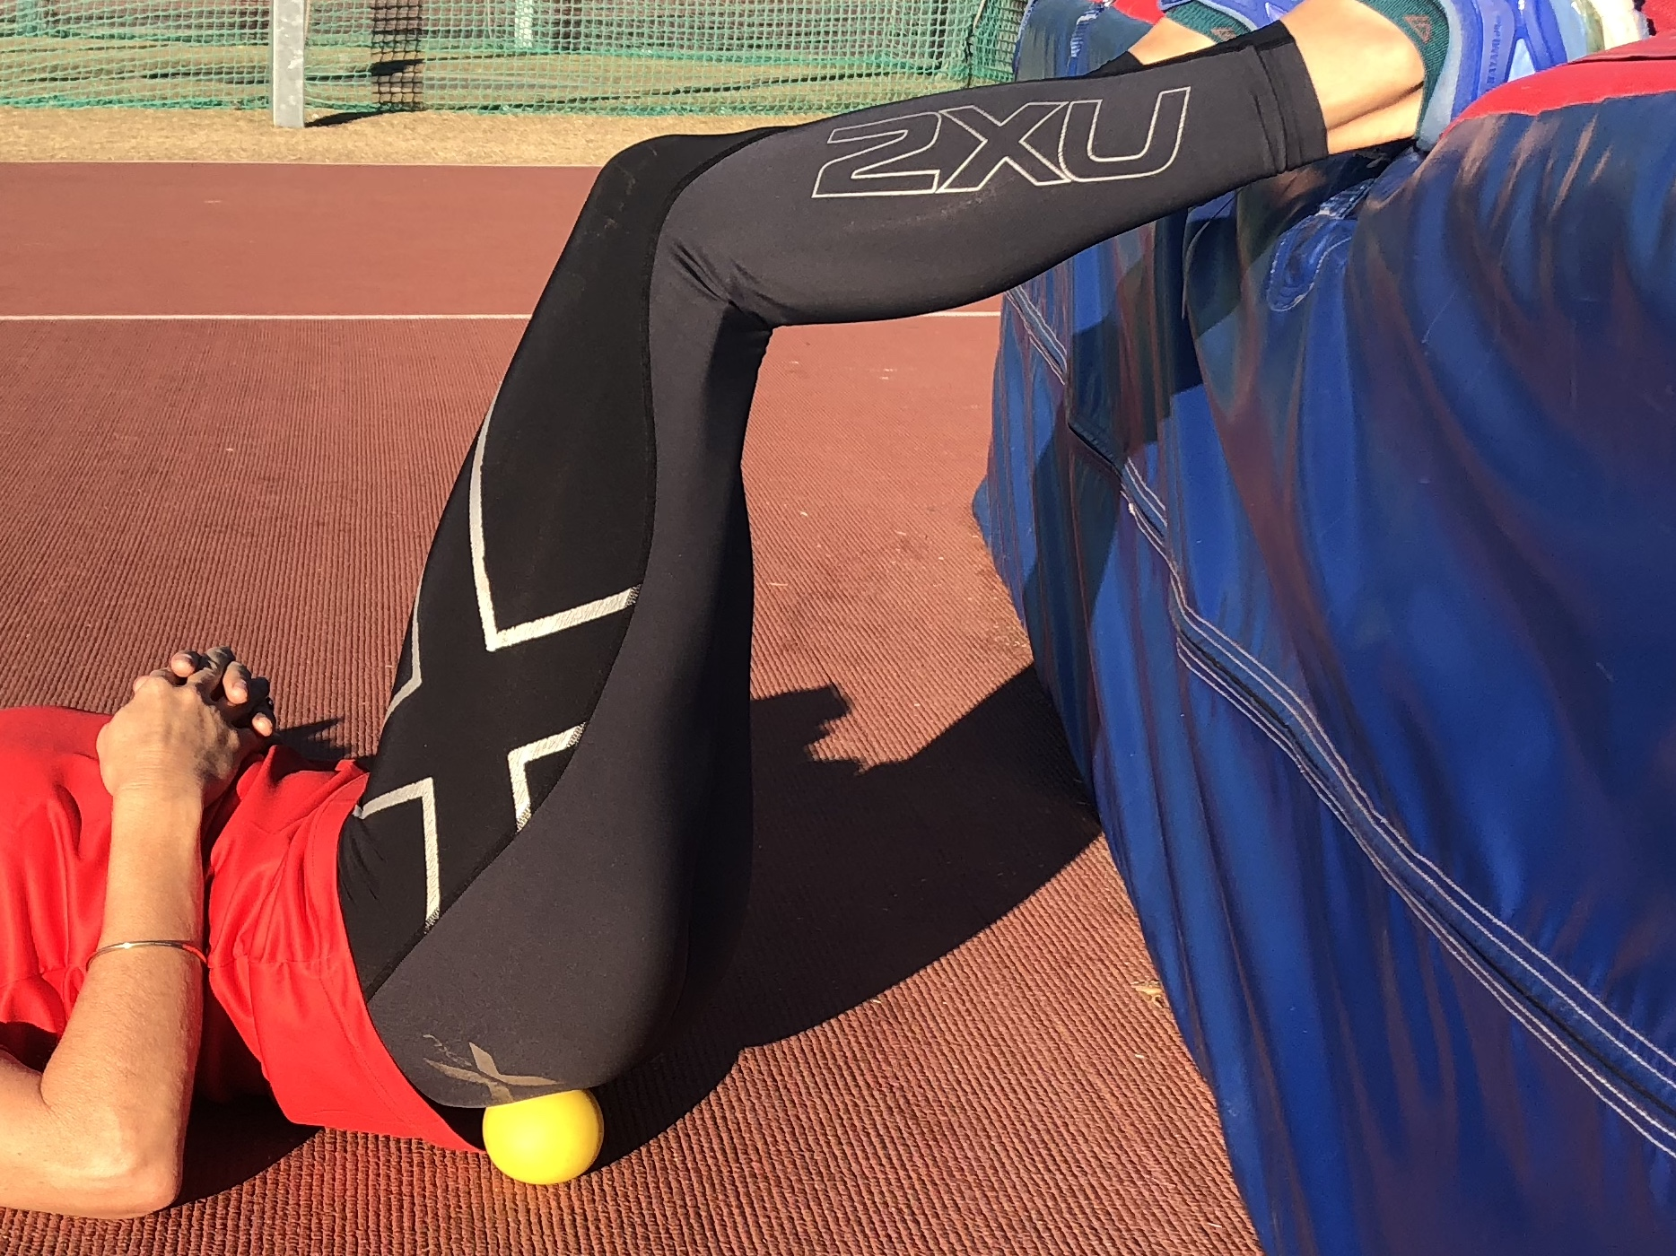
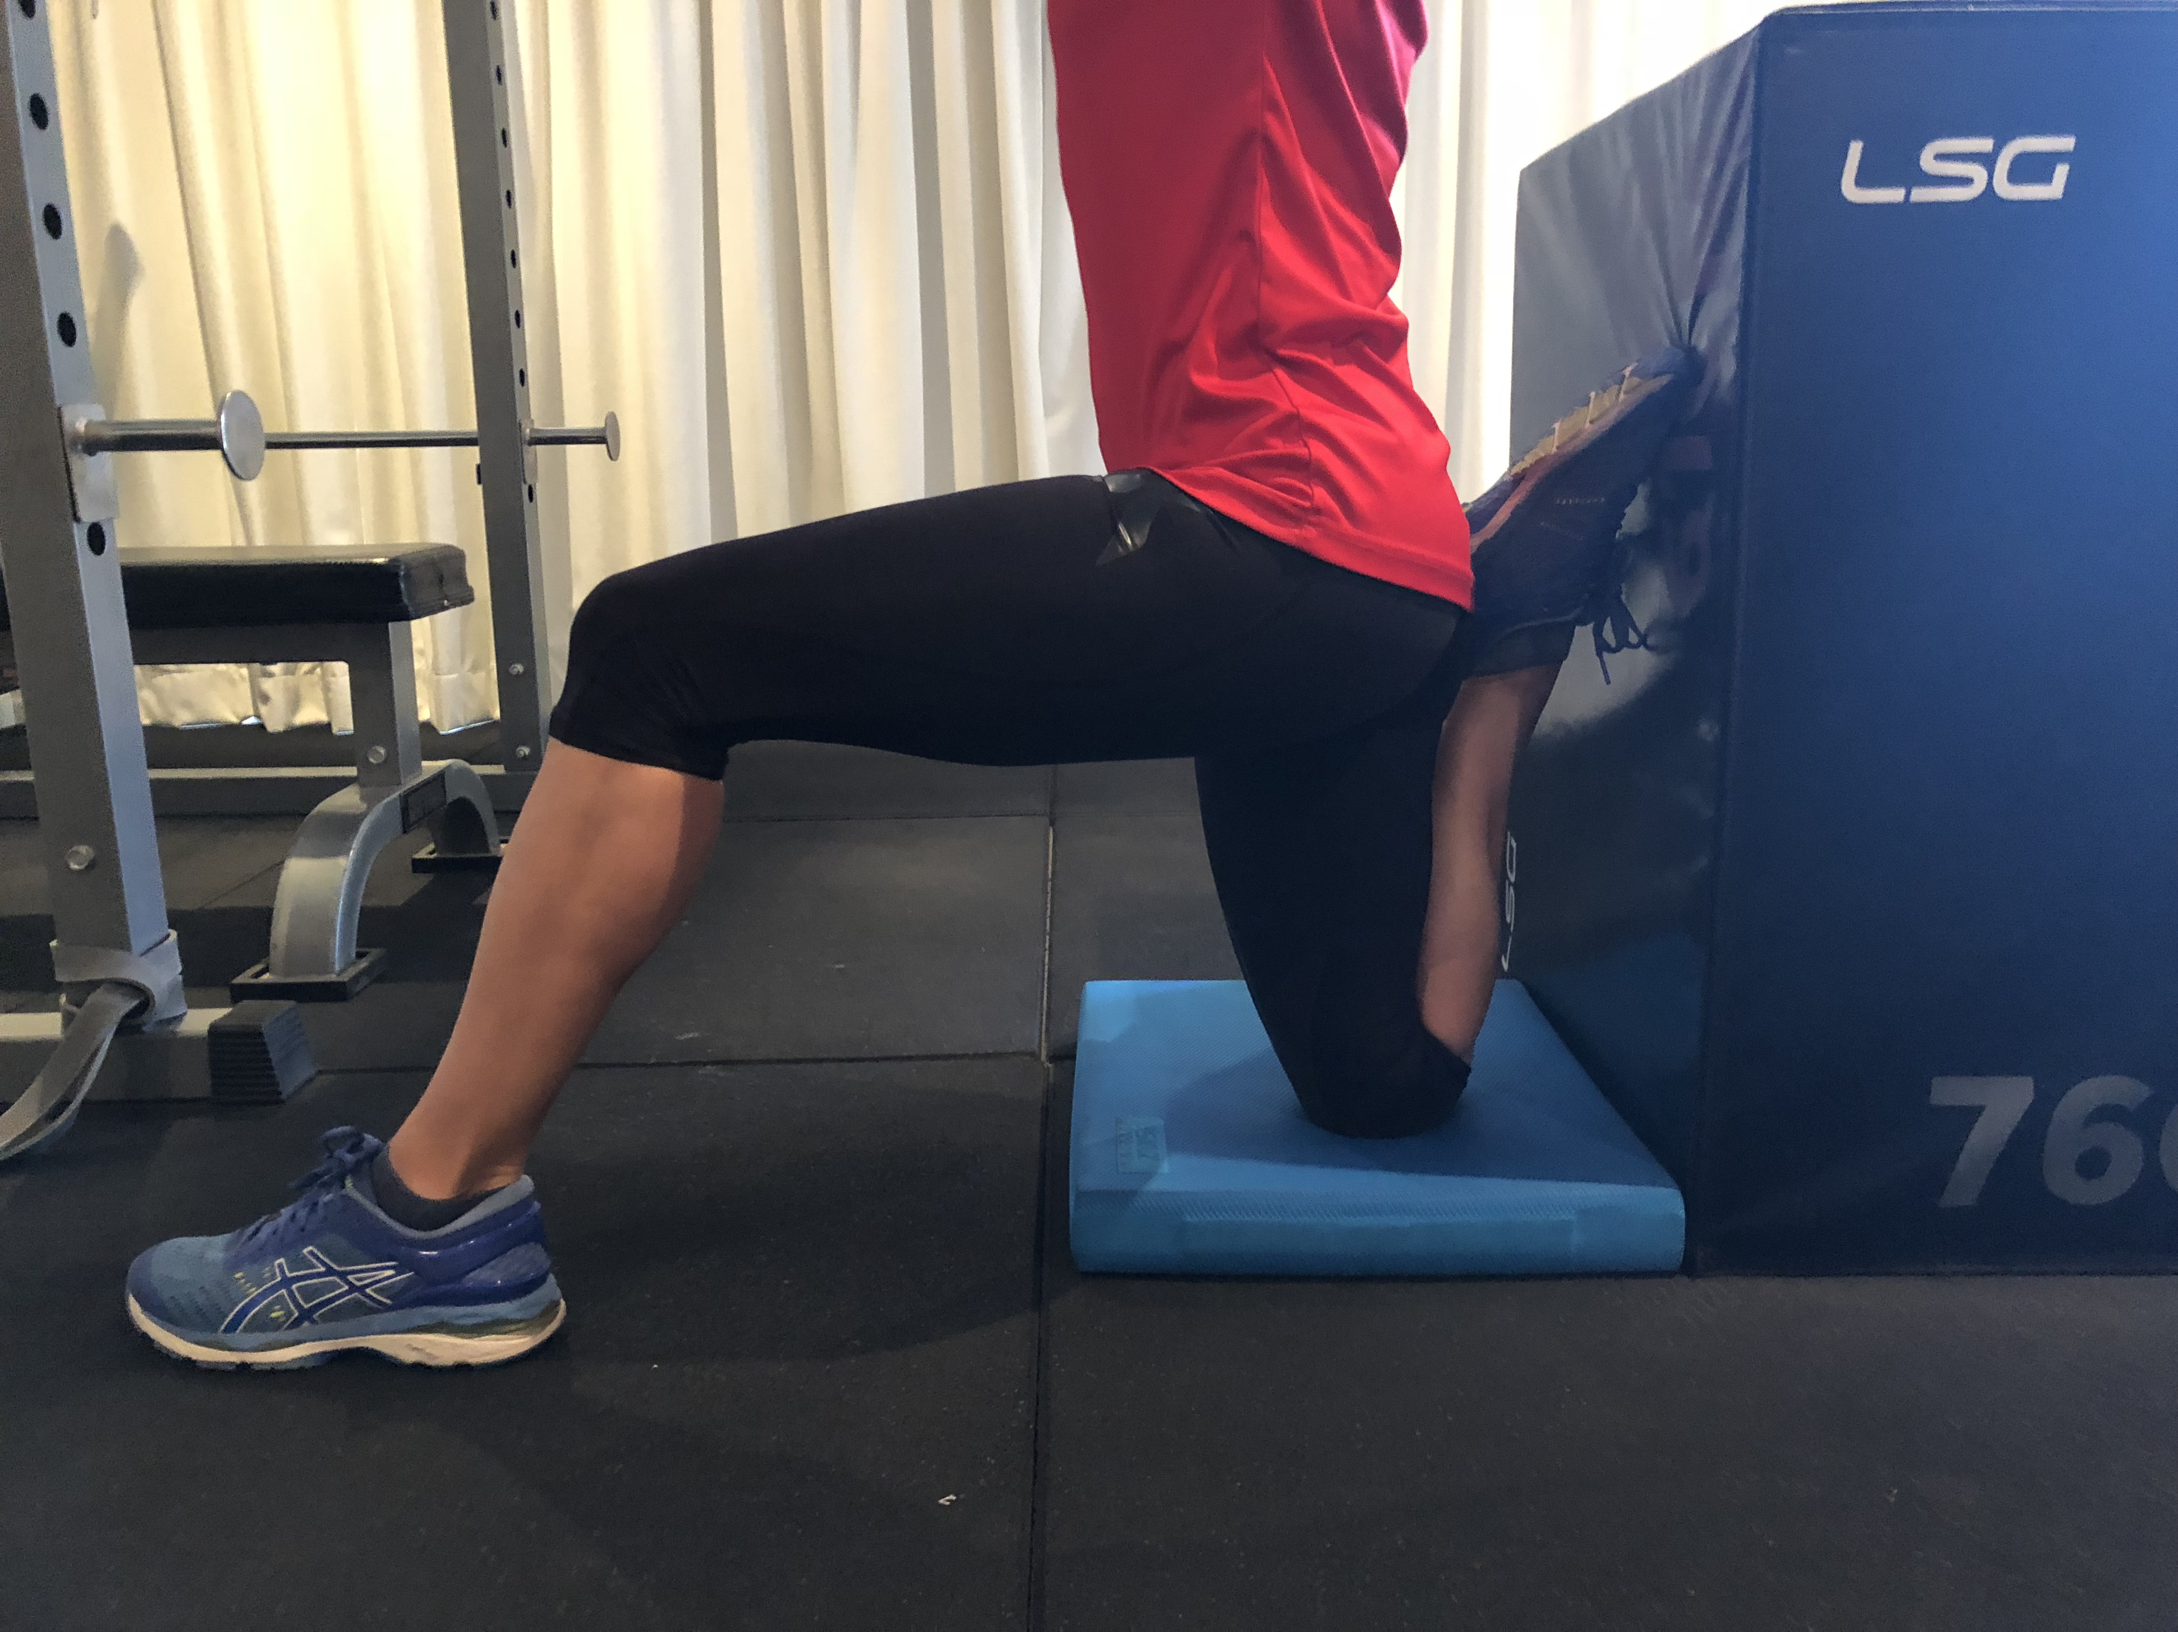
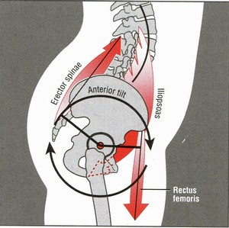
Mobility – pelvic girdle
Distortion of pelvic mechanics commonly found in athletes that compete in field and court sports.
Shortened hip flexors =
diminished acceleration, deceleration & jumping
Lumbo-pelvic instability
Notes:
Mobility – refers to joint motion
Flexibility – refers to muscle length
Review – Mike Boyle’s Joint by Joint approach to training
If an athlete still has shortened or tight hip flexors even after prolonged and regular stretching the athlete may have issues with core control, the Psoas group are also responsible for stabilising the lumbar spine so if this issue persists then an examination of torso stability is required.

Slide 24
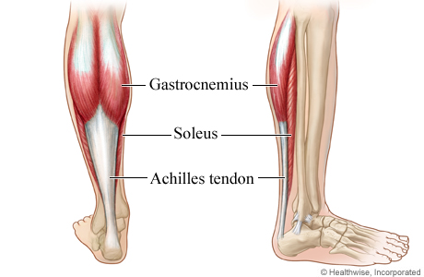
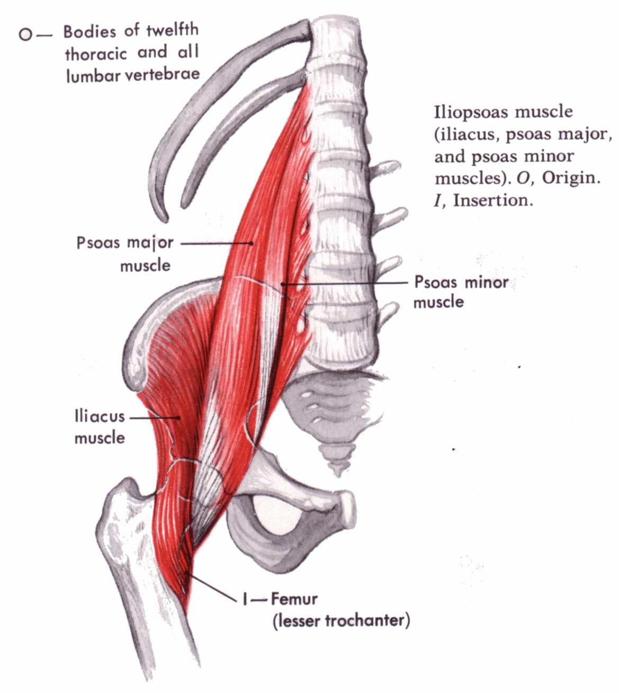
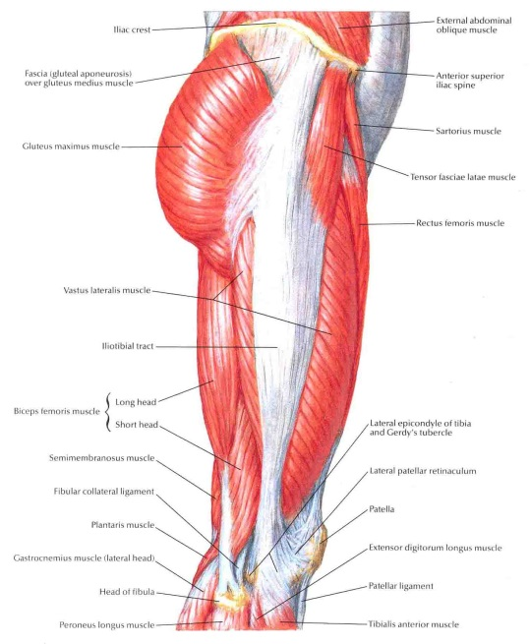
Stretch reflex
Stretch reflex acts similar to loading a sling shot, before shooting the projectile it is poised stretched elastic.
ACHILLES ILIOPSOAS ITB
Tissue integrity and Elastic Properties are Integral to
Sustained High Performance
Notes:
Achilles - Stretched in Dorsi flexion for maximal toe-off
Iliopsoas – Importance of posture, Stretching Hip flexors
ITB – whips the leg backward under the hip – ITB must be free from adhesions

Slide 25
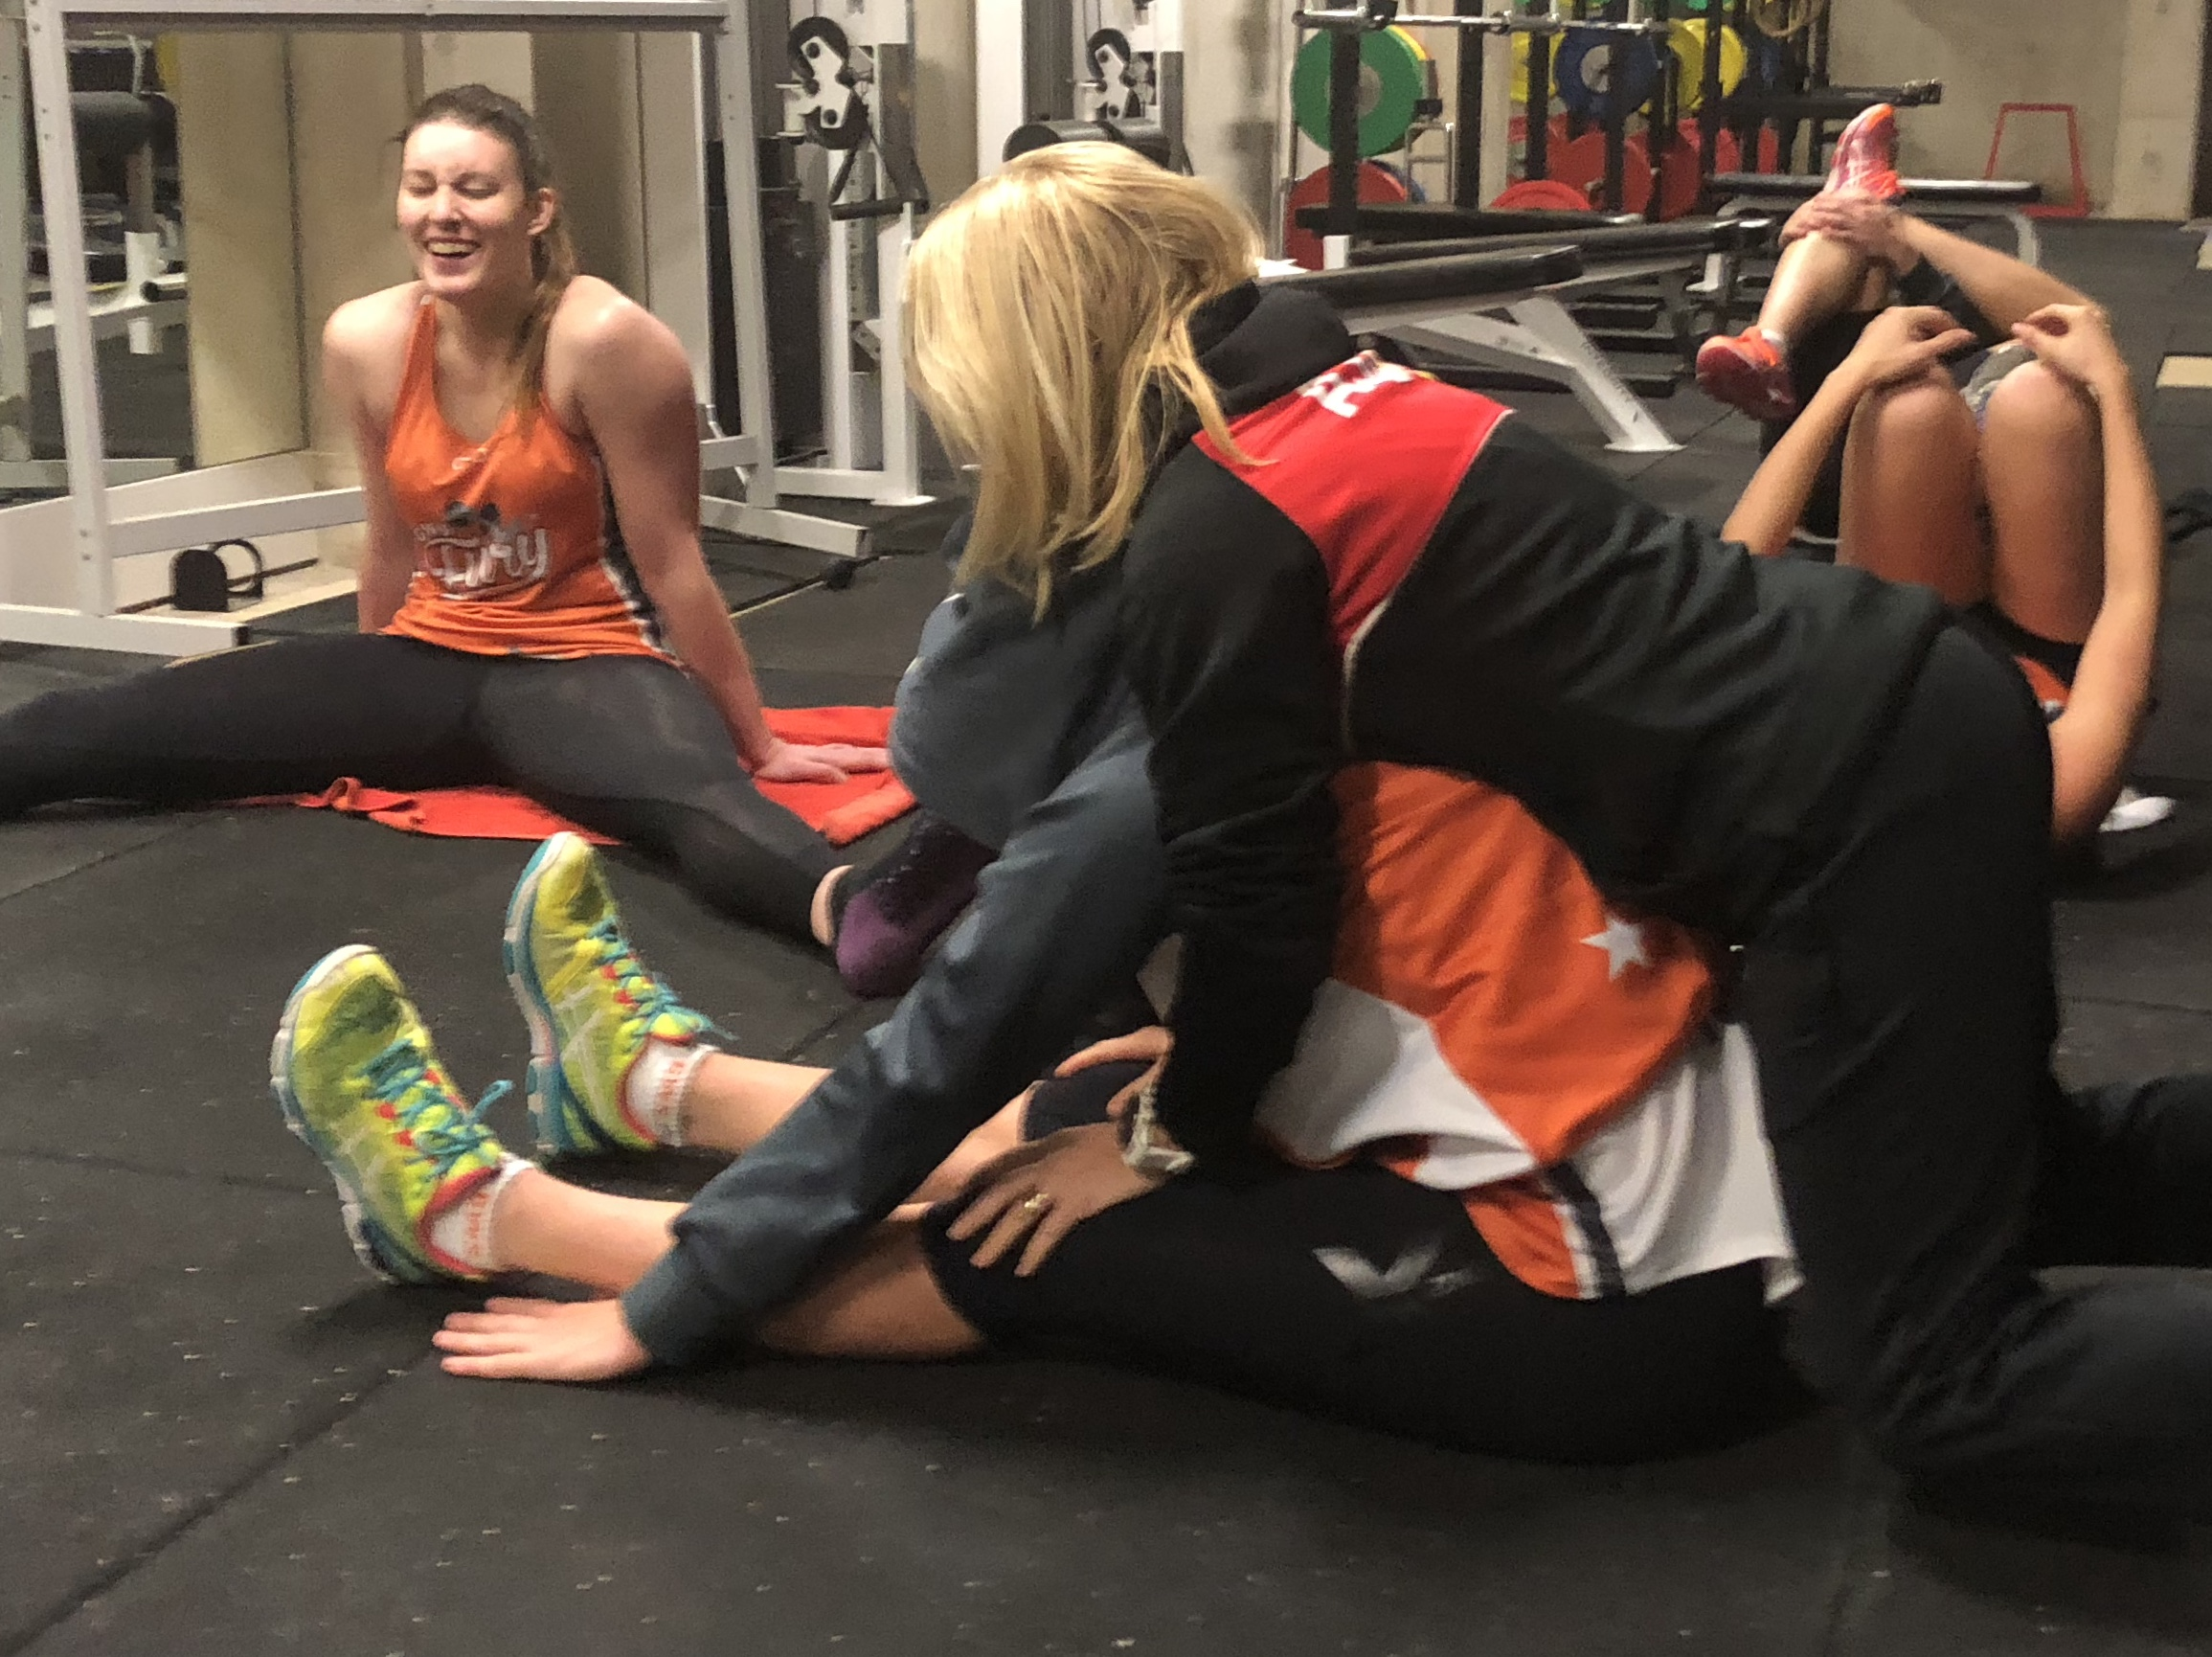
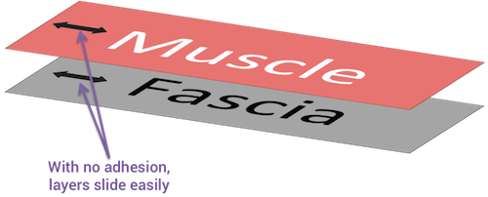
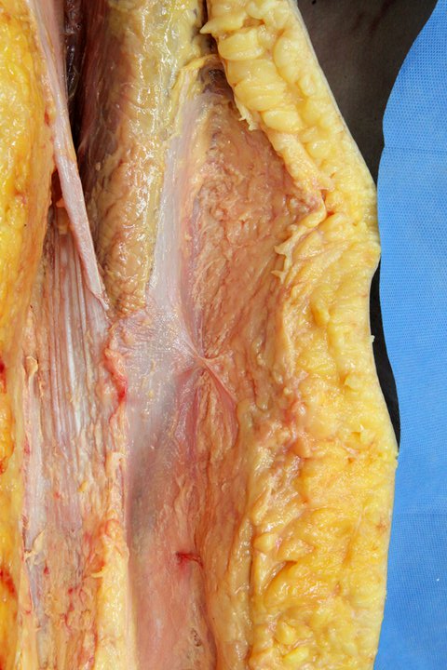
Integrity & Mobility
Tissue Adhesions may develop around sites of previous injury and in areas of high mechanical stress. Points will be painful to touch (hot spots) or compress & will cause motor dysfunction.
MOBILITY = Joint Capsule, Motor Function, Tissue Length
Stretch
Foam roll
Acu-Ball
Massage
Runners stick

Slide 26
Drills to address tightness or lack of function
Posterior tightness
Russian walk
Anterior tightness
Spiderman
Pelvic Stability
Bridging
Activation
Glute extension
Prone ham /glute
Ankle taps
Inchworm
Seated 4
Rear lunge with alt reach
Walking quad
Walking Bridge
Clams
Hip hinge

Slide 27
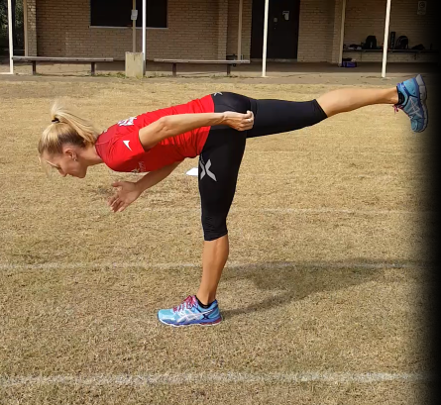
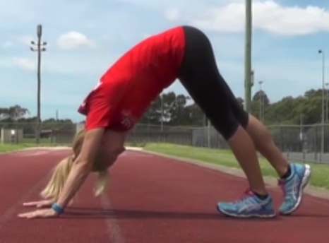
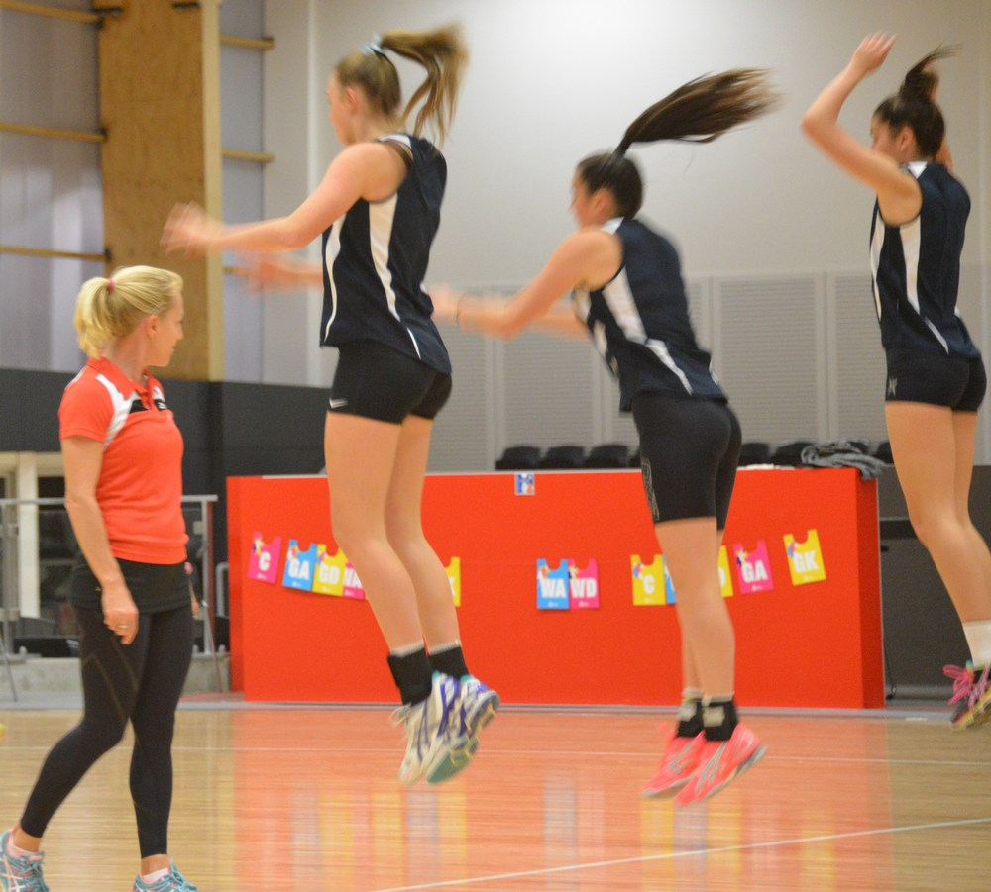
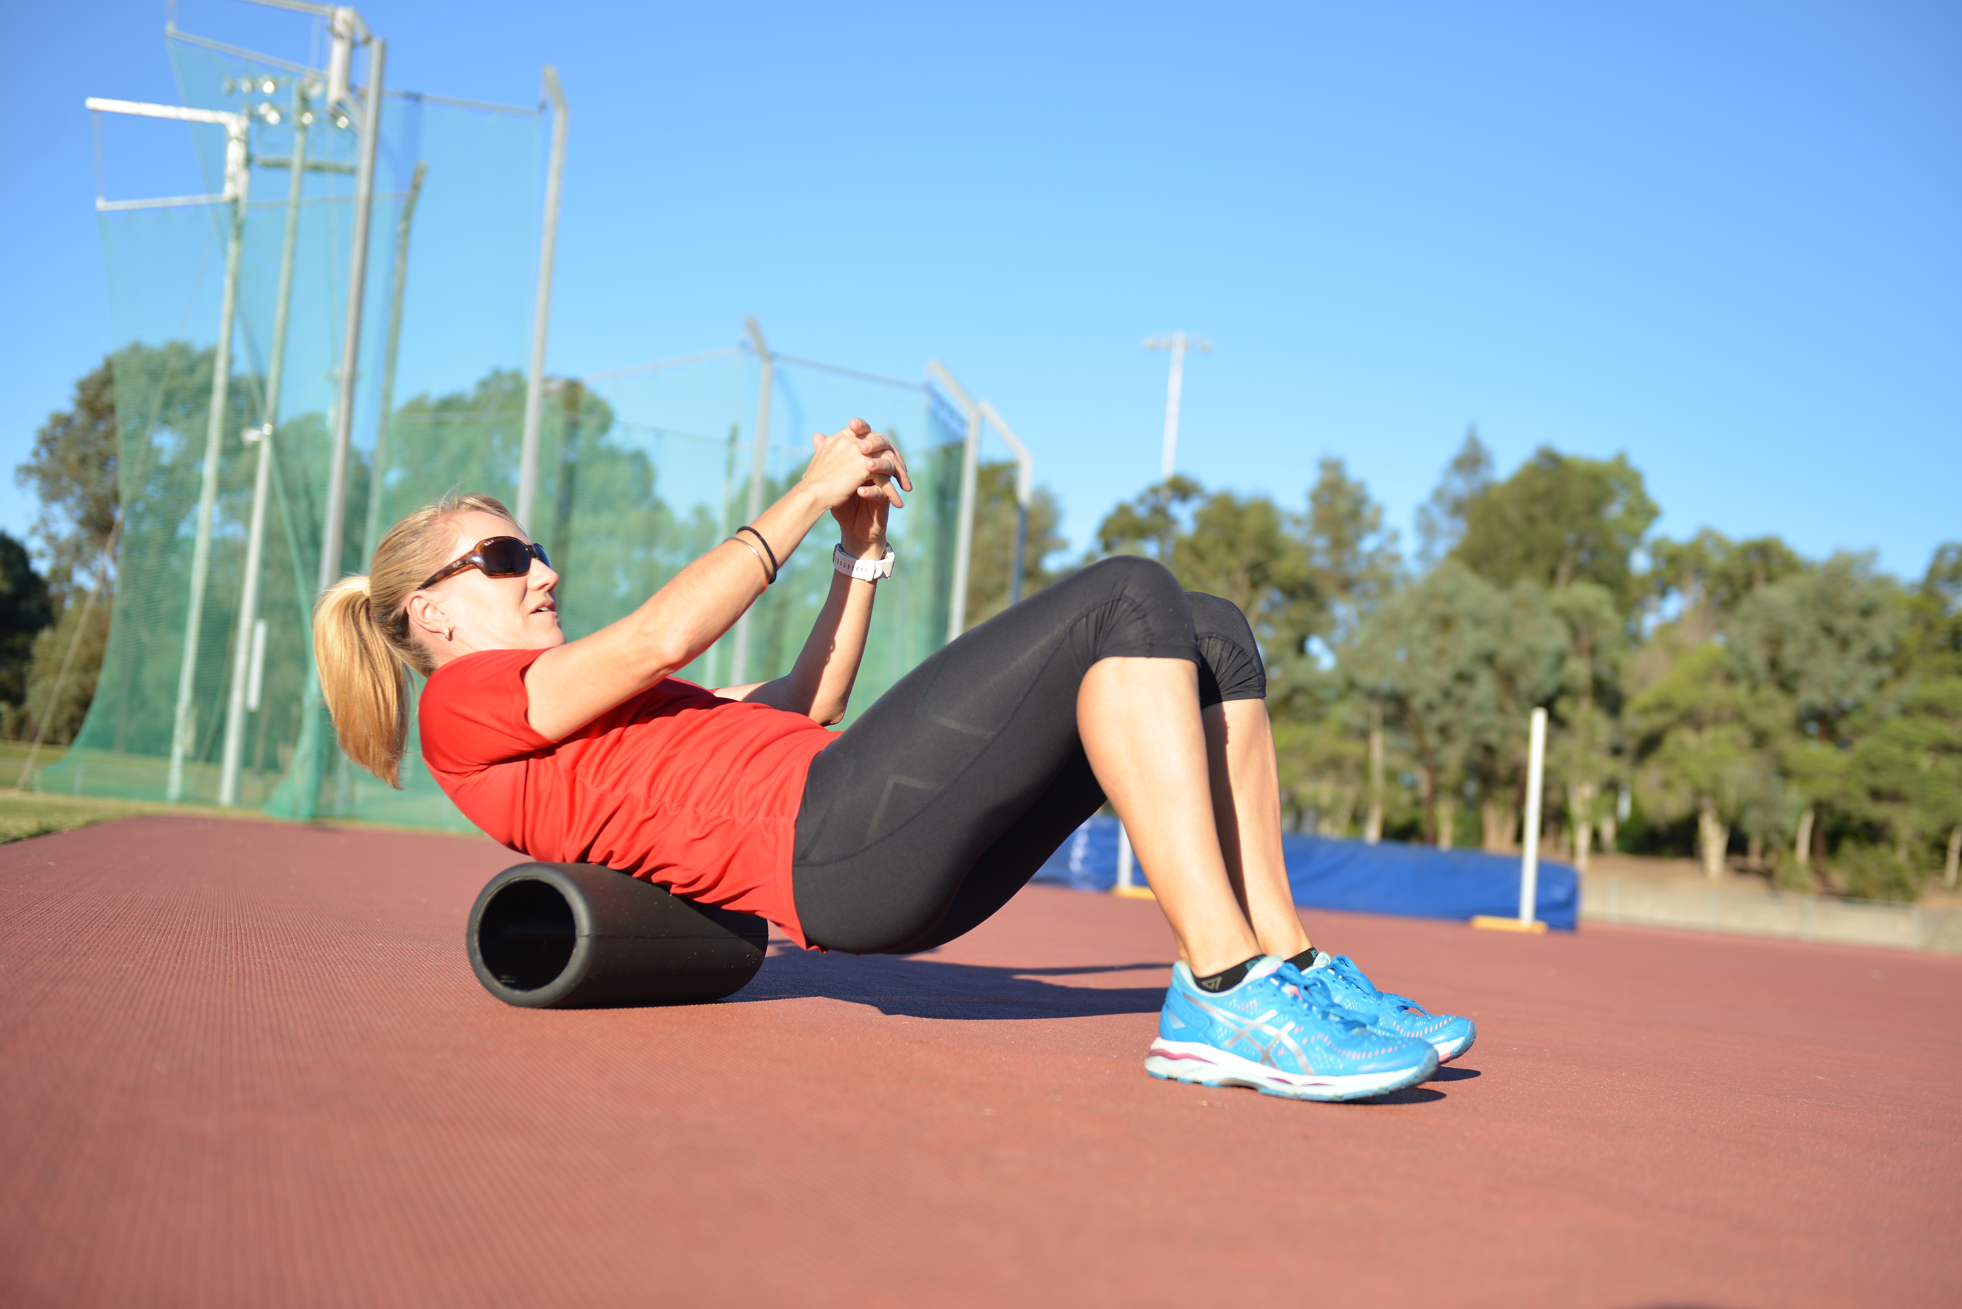
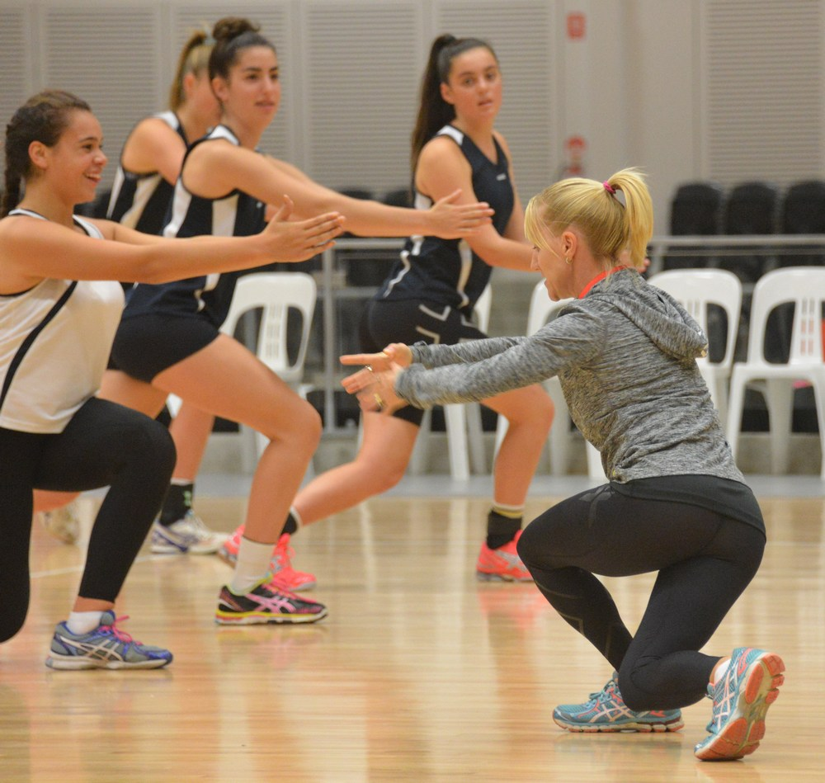
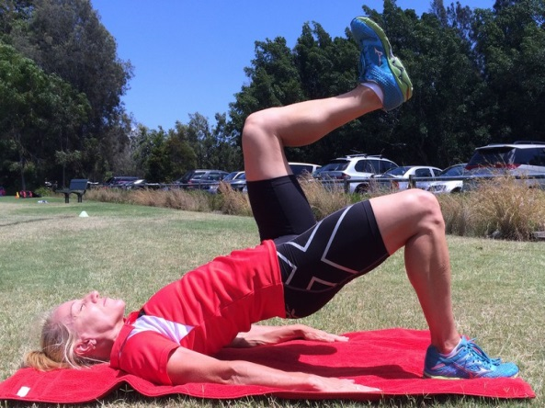
warm up & MOVEMENT prep.
Specific exercises to warm, activate and mobilise.

Slide 28
“While Max velocity speed training may improve both acceleration and maximal sprinting speed, improving horizontal force production capability may be efficient to enhance sprinting performance over short distances”
(Bucheit et al, 2014)
Notes:
The benefit of greater force application is two fold: increased stride length and increased stride frequency

Slide 29
Force development
Combination of technique, strength and stability
Athlete’s must increase force to the ground in the appropriate direction over increasingly shorter periods of time
Increased
STRENGTH
Correct
DIRECTION
Decreased Ground Contact Time
FASTER ATHLETES

Slide 30
Take home points
Improved speed mechanics increases athletic performance by delaying fatigue, decreasing risk of injury and increasing Acceleration, Deceleration, COD & Manoeuvring speed.
Develop physical capacities with an emphasis on concentric strength for acceleration and eccentric strength for deceleration speed.
Explosive COD requires postural integrity, concentric and eccentric force generating capacity.

Slide 31
QUESTIONS ???
Ready for technical practical

