Slide 1
ATHLETIC NUTRITION 24

Slide 2
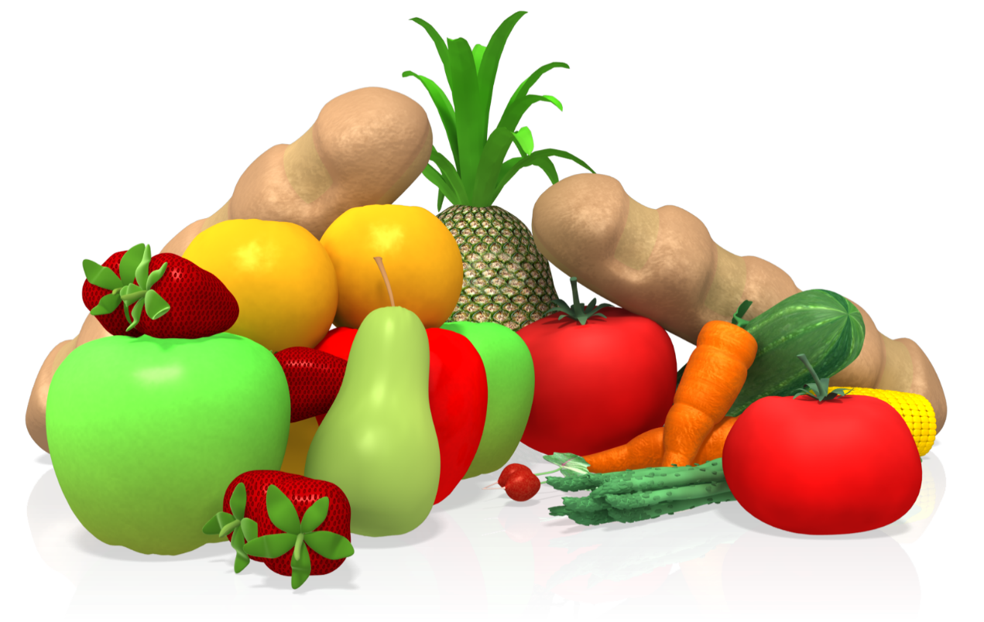
NUTRITIONAL ADVICE FOR ATHLETES
Eat fresh, healthy foods including lean meats, wholegrain carbohydrates, plenty of vegetables and fruit, eating regularly in smaller
balanced meals, and limiting
processed food and
excess fats.
Notes:
Everyone has heard the advice :
Eat fresh, healthy foods including lean meats, wholegrain carbohydrates, plenty of vegetables and fruit, eating regularly in smaller balanced meals, and limiting processed food and excess fats. But what does it really mean and how can we put it into practice ?

Slide 3
WHAT YOU WILL LEARN
What good nutrition looks like
Macro nutrient importance, best sources & quantities
How to customise YOUR fuel consumption
What to consume Before, During and After
Meal Prep & Fuelling between training sessions
Hints for success (Athlete Essentials)

Slide 4
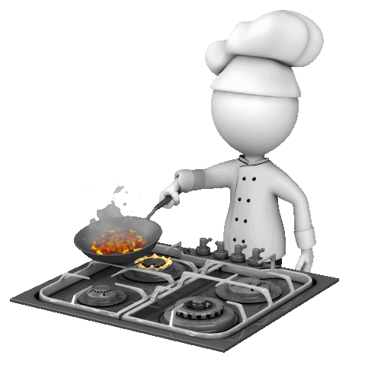
A Rich Culinary Experience OR Fuel for High Performance
FOOD…….
Notes:
There are two ways to think about food, either the deliciousness of it, savouring the taste and the experience of the meal OR, as fuel for performance, fuel for training, nutrients for recovery and growth and maintenance of health and well being. As an athlete your focus should be on food as a fuel for enhanced athletic performance.

Slide 5
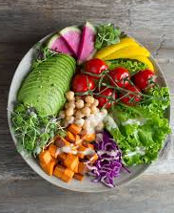
FOOD CHOICES IMPACT YOUR:
Energy levels – you want to attend training full of energy and buzzing with enthusiasm for the session
Immune system – prevention of illness and lessening the duration of sickness is a real benefit
Mindfulness – increasing focus, concentration and positiveness in training
Body composition – maintaining lean mass and decreasing fat mass
Notes:
We want to choose Foods that are choc full of nutrition which we call nutrient dense foods, these foods positively impact our
Energy levels – so you aren’t heading into training or spending your day tired, flat and exhausted, instead you will attend training full of energy and buzzing with enthusiasm for the session ahead.
Our nutritional choices can positively or negatively effect our
Immune system – if as an athlete you are constantly suffering from a sniffle or sore throat, this is a sign that your nutrition needs reworking, prevention of illness and lessening the duration of sickness is a real benefit from choosing nutrient dense foods
Mental health is also influenced – the right foods help you to access your intellect and have increasing focus and concentration, but the wrong foods make you moody, negative and can even cause depression
And of course
Body composition – eating a healthy nutrient dense diet keeps you lean and helps you maintain muscle created through training. There are different choices to be made if our goal is to increase muscle, maintain our current body composition or decrease fat mass, but more of that later
The important thing is Your food choices matter

Slide 6
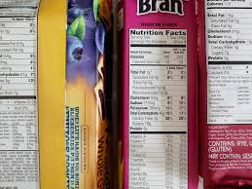
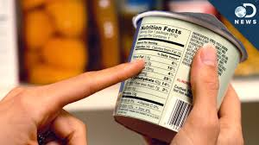
Eat Fresh….. “If it has a food label, it’s probably not food”
Notes:
READ If it came out of the ground or off a tree, if it was made by nature and it’s real. Raw fruits, vegetables, and fish are exempt from nutrition fact labelling because they are natural and from the earth.
A lot of the foods we eat are made in a factory by remnants of food particles, they have added flavourings and preservatives, this is not real food. Eating the wrong foods for your unique system can cause havoc on athletic performance and wellness. Foods such as sugar, trans fats, dairy, farm-raised fish, factory farmed animals and even white bread can cause hormonal imbalances, hives, asthma, moodiness, sore throats, gastrointestinal disorders and inflammation throughout the body.
Try your best for the most part to eat real food in it’s most natural state.

Slide 7
EAT CLEAN
Whole foods – Unprocessed, Unrefined
Do not contain added sugar, salt or fat.
Shopping – food is located on the perimeter of the grocery store. Whole foods have a short shelf life.
Eat foods that are ALIVE
Middle aisles contain ‘foods’ which can last on the shelves for months
Notes:
SO We have decided for enhanced athletic performance and well being to eat clean, this means choosing (READ) foods filled with preservatives, flavourings basically a whole lot of chemicals to make it seem somewhat like food, shop on the perimeter, eat clean

Slide 8
The way we fuel ourselves between training sessions dictates how quickly and completely we recover.
An athlete who eats well performs and recovers well.
Nutrition cannot be an afterthought.
You need to take control of your nutrition and not be at the whim of hunger and cravings.
………….Education is the answer
Notes:
READ You have to think out your nutrition just as you do your training schedule, individual training sessions etc, think of it as an addition to the thought you put into your strength, speed and mobilisation sessions. Not giving nutrition your time and consideration will slow and dampen results from training and hinder recovery. It’s importance cannot be understated.

Slide 9
What Macro’s and How Much
Notes:
Let’s look at our macronutrients that is Carbohydrates, Proteins and Fats what types should we eat and how much of each is a question frequently asked.

Slide 10
Carbohydrates
Is stored in the body as Glycogen in the muscles and liver
Glycogen is broken down into glucose and used as a fuel source
It’s our primary Fuel for Training
Without it – low energy, decreased focus, nasty mood swings
Less processed = more stable energy without insulin spikes
Choose carbohydrates and grains with at least 3 grams of fibre to stabilise energy, keep you full and protect the heart.
Notes:
Is stored in the body as Glycogen in the muscles and liver
Glycogen is then broken down into glucose and used as a fuel source
It’s our primary Fuel for Training and for life
Glycogen depletion is a major cause of fatigue during exercise and training, Without it we have low energy, decreased focus and sometimes nasty mood swings
The goal is to eat Less processed CHO, we want more stable energy without insulin spikes
Insulin is a hormone made by the pancreas that allows your body to use sugar (glucose) from carbohydrates in the food that you eat for energy or to store glucose for future use.
Insulin helps keeps your blood sugar level from getting too high (hyperglycemia) or too low (hypoglycemia).
The insulin response to recovery nutrition is also important but more of that later,
It’s important to Choose carbohydrates and grains with at least 3 grams of fibre to stabilise energy, keep you full and protect the heart.
If your looking to control your weight then Eating high amounts of fibre between 5 to 8 grams per day really helps

Slide 11
Examples:
Steel Cut Oats
Quinoa
Lentils
100% whole wheat bread
Sweet Potatoes
Vegetables
Fruits
Nutrient Dense
Colourful Foods
Notes:
The nutrients provided by grains include carbohydrates/starch (energy), protein, fibre and a wide range of vitamins and minerals
including the B vitamins folate, thiamin, riboflavin, niacin, iron, vitamin E, zinc, magnesium and phosphorus.
The goal is to consume a wide variety of colourful vegetables across the day

Slide 12
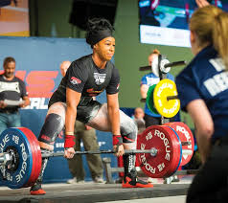
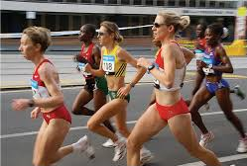
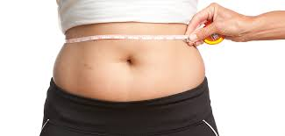
Carbohydrate: How Much?
4.5 to 7 grams /kg/bw/day (Strength & Power athletes)
8 to 10 grams /kg/bw/day (Endurance athletes)
2.5 to 3.5 grams /kg/bw/day (Fat loss)
Notes:
How much carbohydrate you need is dictated by your exercise type, intensity and duration.

Slide 13
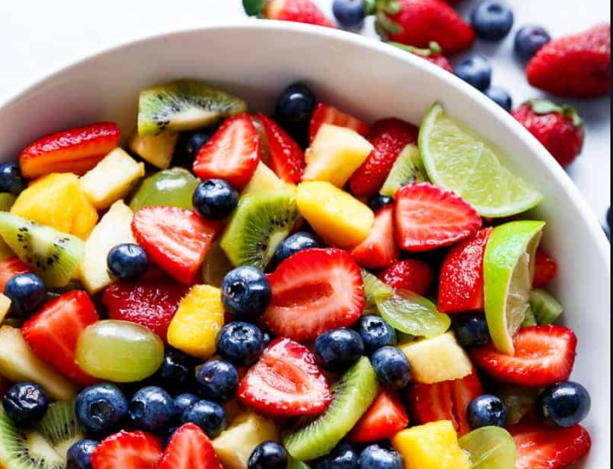
What about Fruit ?
A medium sized piece of fruit contains about 15 grams of CHO.
2 to 3 grams of that will be fibre the rest is natural fruit sugar.
Eat a rainbow of colours for good health
Notes:
Fruit is abundant in vitamins, minerals and phytochemicals or plant chemicals, all of which aid the immune system, reduce inflammation, help to regulate hormones and protect cells and DNA from damage. . Potassium and magnesium is also found in fruit. Magnesium acts as a natural calcium blocker, helping your muscle cells relax after contracting. When magnesium levels are low, your muscles may contract too much and cause symptoms such as cramps or muscle spasms.
Magnesium is found in figs, banana’s and raspberries and in nuts and seeds, it is also found in green vegetables.
Researchers at Harvard University encourage us to eat a rainbow of colours for good health.

Slide 14
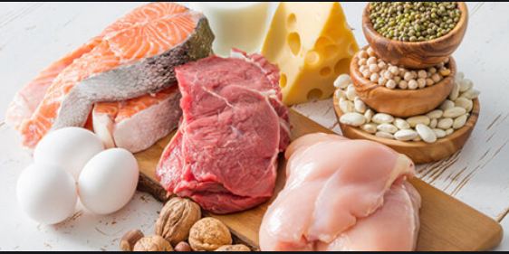
Proteins
Stabilisers energy and Promotes satiety
Provides the amino acids necessary to rebuild muscle tissue that is damaged during intense exercise
Increases the absorption of water from the intestines and improves muscle hydration
Stimulate the immune system, making you more resistant to colds and other infections
Increases metabolism
Notes:
Proteins are large, complex molecules that play many critical roles in the body. They do most of the work in cells and are required for the structure, function, and regulation of the body's tissues and organs.
Every meal and snack should contain protein

Slide 15
Examples:
Foods from this food group fall into 6 categories.
Lean meats - Beef, lamb, veal, pork, kangaroo
Poultry - Chicken, turkey, duck, emu, goose
Fish and seafood - Fish, prawns, crab, lobster, mussels, oysters, scallops, clams
Eggs - Chicken eggs, duck eggs
Nuts and seeds - Almonds, pine nuts, walnut, macadamia, hazelnut, cashew, peanut, nut spreads, pumpkin seeds, sesame seeds, sunflower seeds, brazil nuts
Legumes/beans - All beans, lentils, chickpeas, split peas, tofu.
Notes:
More importantly however, this food group also provides a wide variety of other nutrients such as: iodine, iron, zinc, vitamins, especially B12, and essential fatty acids.

Slide 16
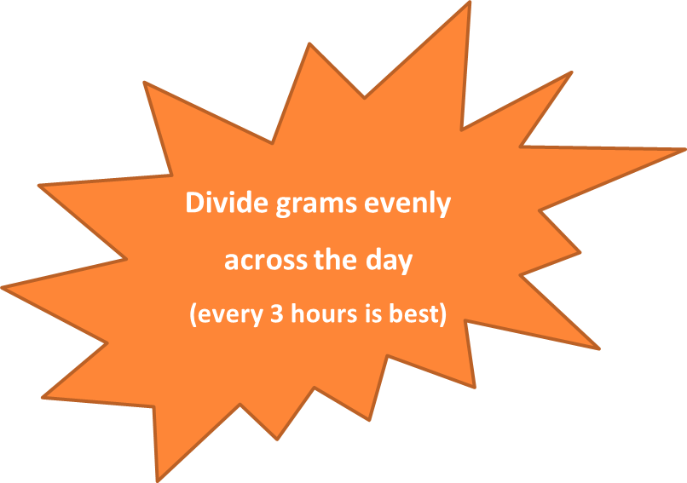
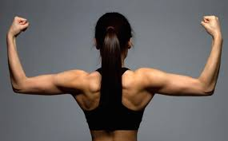
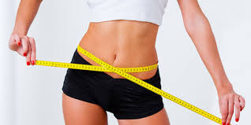
Protein: How Much?
Maintenance: 1 – 1.4 grams/kg/bw/day
Building muscle: 2- 2.5 grams/kg/bw/day
Fat loss: 2.2 grams/kg/bw/day

Slide 17
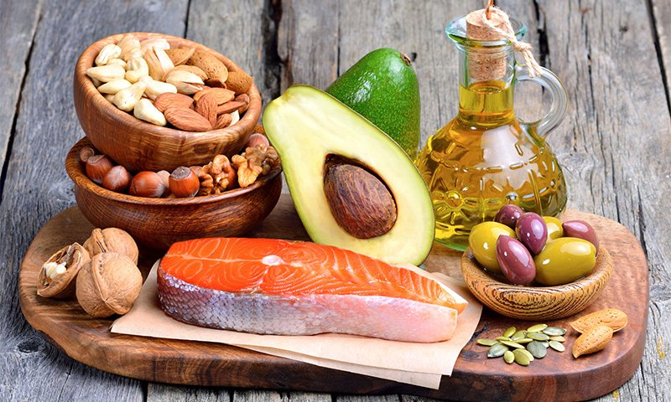
Fats
Crucial to good health (cell membranes)
Needed to absorb vitamins and anti-oxidants
Omega 3 fatty acids are ESSENTIAL for brain function and as a natural inflammatory
Needed for cellular repair of joints, organs, skin and hair
Promotes satiety
Regulates blood sugars
Notes:
Fat consumption should be a minimum of 20 percent of total energy intake to preserve athletic performance. Maintaining adequate fat intake is crucial to meeting nutritional needs of essential fatty acids and fat-soluble vitamins, A, D, E and K.
Since trans fatty acids are the most damaging to the heart, athletes should limit their intake of the following:
Fried foods
Margarine
Other foods with hydrogenated oils

Slide 18
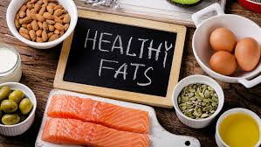
Examples:
Pecans, almonds, walnuts
Natural nut butters
Olive oil
Avocado
Omega 3 sources =
Walnuts, salmon, tuna, flaxseed
Chia seeds
Notes:
Polyunsaturated fats:
omega-3 fats which are found in fish, especially oily fish
omega-6 fats which are found in some oils such as safflower and soybean oil, along with some nuts, including brazil nuts.
Monounsaturated fats:
found in olive and canola oil, avocados and some nuts, such as cashews and almonds.

Slide 19
Water & Hydration
There is nothing better to drink than water
We simply don’t drink enough
Drinking sufficient water:
Increases energy
Improves quality of skin and fascia
Lubricates joints and Muscles
Prevents over eating
Regulates appetite
Impacts mental abilities – dehydration increases cortisol (stress hormone)

Slide 20
H2O Advice
35ml per Kg of BW per Day
Sip on Water between meals
Monitor Urine colour
Avoid Caffeine Base drinks
You will always wake up dehydrated,
drink 2 glasses of water upon rising
Notes:
35mls per kg of bodyweight per day = 2.3 litres for a 65kg athlete

Slide 21
Urine Colour Chart
NOTE: Combine urine colour charts with bodyweight checks before and after training for an accurate hydration check.
Notes:
Combine urine colour charts with bodyweight checks before and after training for an accurate hydration check.
Note: Supplements such as vitamin tablets will change the colour of your urine for a few hours post consumption, making it bright yellow or discoloured.

Slide 22
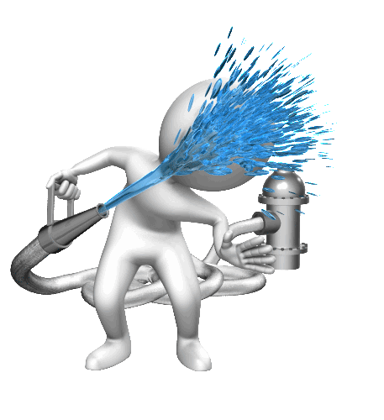
Staying Hydrated through Training
PRE-TRAINING
Start pre-hydration several hours prior to allow time for absorption
DURING TRAINING
Take small sips regularly avoid gulping large volumes which will result in increased urination through training
POST-TRAINING
Prevent Dehydration or changes in bodyweight greater than 2% of body mass. Replace electrolytes if needed.
Training | Drink up
Pre training (1-2 hrs) | 500 – 600mls
Immediately before | 250 – 300mls
During training | 250 – 300mls
Post training | 1 kilogram lost = 1 litre
Notes:
To really get our in training hydration right, we want to look at not only the water we consume during the training session but also what we do in the hours leading up to and the hours after training.
The idea is to Start pre-hydration several hours prior to allow time for absorption, small sips on a regular basis for the 1 to 2 hours leading up to training you want to drink 500 – 600mls of water.
Immediatley before training drink another 250 – 300 mls, then step on the scales and get your pre-training weight. Throughout training, drink another 250 – 300mls, be sure to take small sips regularly through training you want to avoid gulping down large quantities which will result in increased urination needs through the session. Then post training weigh yourself as advised earlier and identify your fluid needs based on bodyweight loss. If for example you have identified that you have lost 1 kg in BW during training then you will need to drink 1 litre of water to replace the fluid lost.

Slide 23
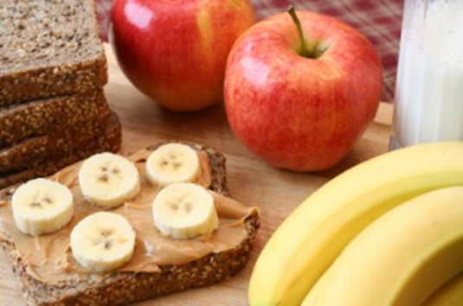
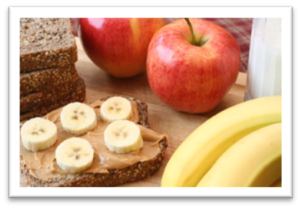
Before Training / Game -
Don’t be deprived of key nutrients when training.
Top up liver glycogen stores whilst maintaining level blood glucose (muscle glycogen provides fuel whereas the blood sugar level controls functioning of the brain and nervous system).
Notes:
The goal of pre-training food is to ensure that you are not deprived of key nutrients when you need them. READ

Slide 24
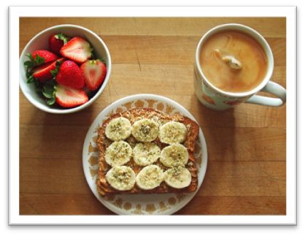
What to Eat Before
Easily Digestible Carbs & a little Protein
Whole wheat toast with nut butter
Half an apple and a handful of nuts
Watered down juice with a scoop of protein powder
Yoghurt, berries and granola
Half a lean meat sandwich and piece of fruit
Banana and small handful of cashews
Small bowl of quality cereal
Notes:
Good nutrition can help your body perform better and recover faster after each workout.
Optimal nutrient intake prior to exercise will not only help you maximize your performance but also minimize muscle damage
To maximize the results of your training, try to eat a complete meal containing carbs, protein and fat 2–3 hours before you exercise.
However, in some cases, you may not be able to get in a full meal 2–3 hours before working out.
In that case, then you can still eat a decent pre-workout meal. However, keep in mind that the sooner you eat before your workout, the smaller and simpler the meal should be.
If you eat 45–60 minutes prior to your workout, choose foods that are simple to digest and contain mainly carbs and some protein.
This will help prevent any stomach discomfort during exercise. READ

Slide 25
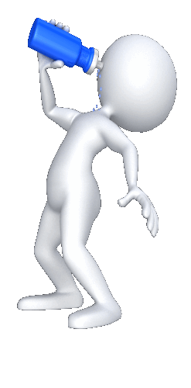
DURING TRAINING & COMPETITON
Replenish water
Depending on length and type of training glucose polymer and amino acid mix may be helpful
Notes:
In general you won’t need extra fuel (carbohydrate) during exercise sessions lasting less than ~60 minutes (and possibly up to 90 minutes if the intensity of the session is low or there are several breaks).
However, if your training session or event is longer than 60-90 minutes topping up with extra carbohydrate during the training session can help to:
Maintain blood glucose levels to fuel your muscles and brain during exercise
Get the most out of your training session by sustaining intensity for longer

Slide 26
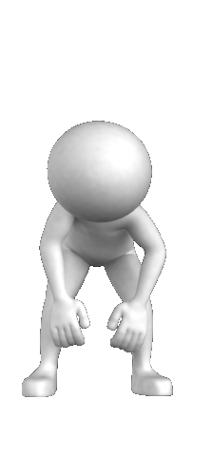
What can go wrong ?
Failing to fuel or hydrate correctly during exercise can result in:
Earlier onset of fatigue
Reduced speed, especially during repeat efforts
Reduced endurance
Poor concentration and decision making
Skill errors
Gut upset
Notes:
Getting your nutrition plans wrong during training or an event usually means that you don’t optimise your potential during the session.
Early onset of fatigue (commonly referred to as “hitting the wall” or “bonking”)

Slide 27
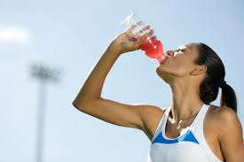
How Much and How Often ?
4 to 6 mouthfuls of water every 15 minutes
If training longer than 60 mins drink a sports drink that has 200 milligrams of sodium per 250mls.
When training longer than 60 mins have 30 – 60 grams of CHO per 60 mins.

Slide 28
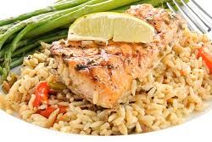
Post Training / COMPETITION
Fuel within 15 mins post training then follow up with a meal
60 – 90 mins later
Correct Recovery fuel will:
Increase blood insulin levels
Lower blood cortisol levels
Strengthen the immune system
Restore muscle and liver glycogen
Stimulate muscle protein synthesis and repair

Slide 29
Post Training / COMPETITION -
Water for hydration (weigh before and after training)
Carbohydrate needs =
1 gram of CHO per kg of BW within 15 mins post training
Carbohydrate Plus Protein Speeds Recovery
Research shows that combining protein with carbohydrate within 30 mins of exercise nearly doubles the insulin response, which results in more stored glycogen.

Slide 30
CARBOHYDRATE & Protein
The optimal carbohydrate to protein ratio for this effect is 4:1 Eating more protein than that has a negative impact as it slows rehydration and glycogen replenishment.
One study found that athletes who refuelled with carbohydrate and protein had 100% greater muscle glycogen stores than those who only ate carbohydrate.
Notes:
I have found the fastest and easiest way to get this perfect blend is through a high quality recovery shake, the fluid makes it easy to consume within the prescribed timing. The best recovery shakes will support maximum Glycogen Replenishment and create a Crucial Anabolic Drive post exercise.

Slide 31
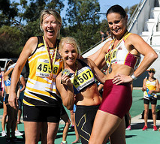
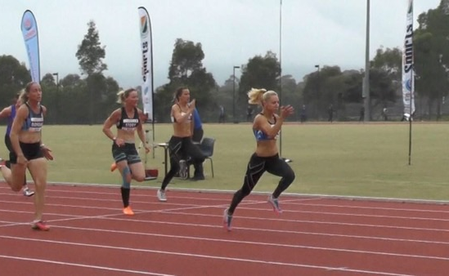
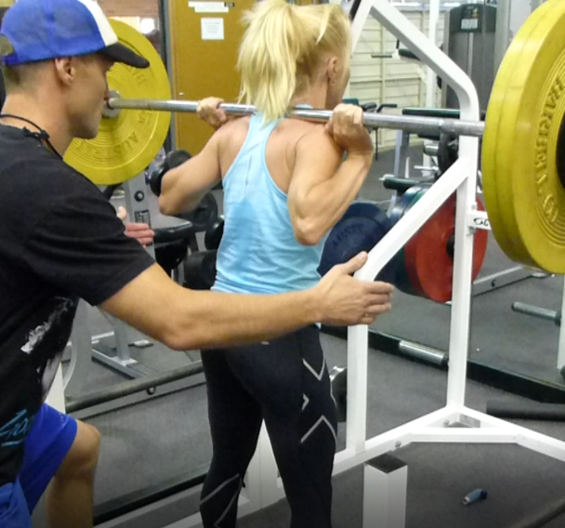
Recovery Shake: My choice
Notes:
My training and competition was fuelled by Gen tecs TR3 shake which allowed me to finish track training at 8pm at night and be ready to hit the gym at 7:30 the next morning. It has the perfect blend of Protein carbohydrate and micro nutrients.

Slide 32
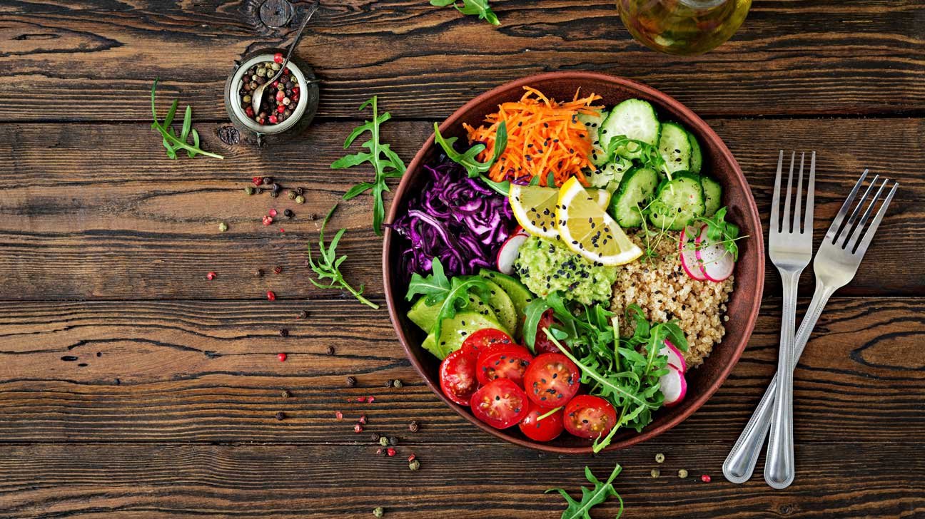
Vegetarianism
Healthy meat alternatives include: beans, lentils, chickpeas, tofu and other soy products, nuts, nut butters, seeds, and eggs, dairy and fish (if you eat them)
Don’t eat dairy: special consideration to calcium, vitamin D, and vitamin B12.
Notes:
Let me make a small note here for our vegetarian athletes - As a vegetarian, you need to replace the meat portion of your diet with a variety of healthy meat alternatives such as beans, lentils, chickpeas, tofu and other soy products, nuts, nut butters, seeds, and eggs, dairy and fish (if you eat them)
If you eliminate dairy products as well, you need to consider calcium and vitamin D, and when you eliminate all foods of animal origin, vitamin B12 also needs special attention.

Slide 33
Customising for YOUR Success
Grams per macro, Counting Calories & More
Notes:
Foe real nutritional success, that is achieving your athletic goals sooner, it’s important to eat clean foods at the right time and in the right amount. Over the next few slides I will show you how to calculate your own personal winning formula.

Slide 34
Personalise your Nutrition: CHO & PRO
Gender | Training Frequency | Build Muscle | Maintain Weight | Lose Fat
Men | 5 + times / week | 44 –52 | 42 | 35 - 38
Woman | 5 + times / week | 38 –48 | 32- 40 | 30 - 35 + Aerobic exercise
WOMEN | Macronutrient | Build Muscle | Maintain Weight | Lose Fat
 | Protein | 2.0-2.2 grams | 1.4 grams | 2.2 grams
 | Carbohydrate | 5.5- 6.5 grams | 5 - 6 grams | 2.5 - 3.5 grams
MEN | Macronutrient | Build Muscle | Maintain Weight | Lose Fat
 | Protein | 2.5 grams | 1.4 grams | 2.2 grams
 | Carbohydrate | 6 - 7 grams | 5 -7 grams | 3 - 4 grams
Notes:
The advice on this slide is based on my own research over many years, for your exact personalised requirements please see a qualified dietician or nutritionist.
The numbers represent calories per kg of bw per day, if you are accustomed to using kilojoules then multiply the numbers by 4.1. Remember this webinar is all about athletic nutrition, most athletes train more than 5 times per week. If you are a novice or recreational athlete you will need less energy than the above recommendations. These recommendations are for strength oriented athletes who for example may do 3 to 4 strength and an additional 3-4 team or conditioning training sessions each week. These quantities are not for general population or for novice athletes who have far less energy needs.
Let’s look at the macro nutrient requirements. Each figure is the number of grams per kg of BW per day.
Vegetarians need to add 10% more protein than suggested above.
Endurance athletes training for events such as the marathon or ironman triathlons etc will need 8-10 grams of CHO per day.

Slide 35
Personalise your Nutrition: Fat
To determine your fat grams, first calculate your personalised CHO and PRO needs.
The rest of your calories will be in fat.
Protein and Carbohydrate both have
a value of 4 calories per gram.
Fat contains 9 calories per gram.
Divide your fat calories by 9 and
you have your grams of fat.

Slide 36
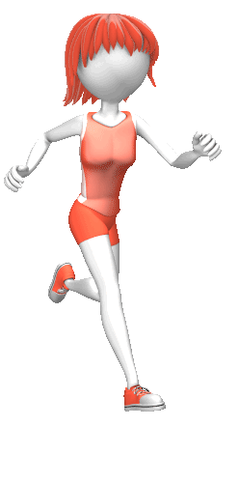
Example of fat needs:
19yr old female athlete - 176cm tall - weighing 65kg training intensively 7 times a week requires around 2,500 calories a day
Protein at 1.4 grams per kg = 91 grams @ 4 calories per gram = 364 calories
Carbohydrate at 6 grams per kg = 390 grams @ 4 calories per gram = 1560 calories.
Protein + Carbohydrate calories = 1924 calories
Fat needs math: 2500 – 1924 = 576 calories from fat / 9 calories per gram
= 64 grams of fat per day
Notes:
Example: A 19yr old female athlete at 176cm tall and weighing 65kg, training intensively 7 times a week requires around 2,500 calories a day to maintain her current body composition.
Protein at 1.4 grams per kg = 91 grams @ 4 calories per gram = 364 calories
Carbohydrate at 6 grams per kg = 390 grams @ 4 calories per gram = 1560 calories.
Protein + Carbohydrate calories = 1924 calories
2500 – 1924 = 576 calories from fat / 9 calories per gram = 64 grams of fat per day

Slide 37
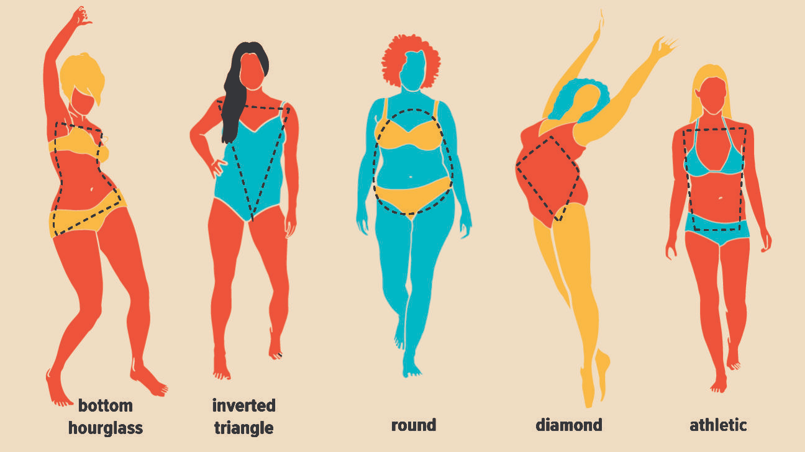
We are all different
A smaller woman may need fewer than 9 calories per kg of bodyweight per day to maintain weight.
There is a lot of trial and error when it comes to female prescription as all of the research is done on men, so don’t be afraid to experiment with what works best for you
Notes:
The larger and more muscular a woman is the more kilojoules she can handle for maintenance.
A smaller woman may need fewer than 9 calories or 38 kj per kg of bw per day to maintain weight. There is a lot of trial and error when it comes to female prescrption as all the research is done on men. Keep a journal .

Slide 38
Complete Example
CASE STUDY: 15 yr old female athlete weighs 62 kg and wants to drop 2 to 3 kg of fat mass while maintaining lean muscle mass. She currently trains 6 times a week doing resistance training, HIIT and team training.
30 calories per kg of body weight per day = 1860 total calories
3 grams of Carbohydrate per KG of BW = 186 grams of CHO @ 4 calories per gram = 744 calories
2.2 grams of Protein per KG of BW = 136.4 grams of PRO @ 4 calories per gram = 545.6 calories
744 + 545.6 = 1289.6 calories, subtract from total calories (1860) = 570.4 calories from fat
570.4 calories divided by 9 calories per gram = 63.3 grams of healthy fats.
MACRONUTRIENT | GRAMS | CALORIES
Carbohydrate | 186 | 744
Protein | 136.4 | 545.6
Fats | 63.3 | 63.3
 | TOTAL CALORIC INTAKE | 1860

Slide 39
RANELL’S TIPS FOR

Slide 40
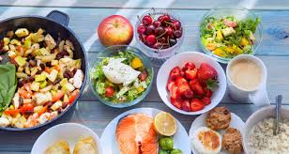
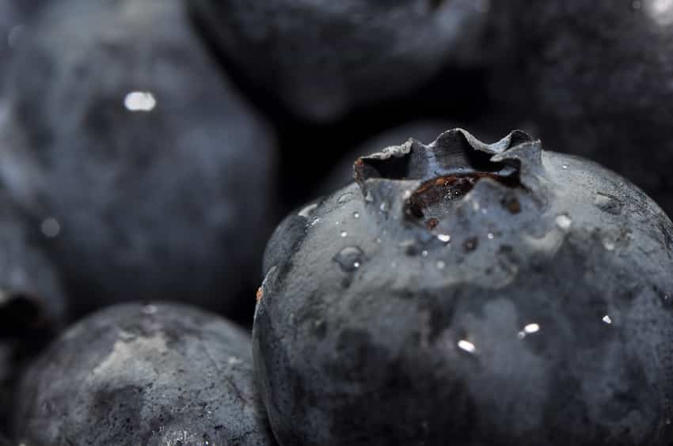
Tip 1: You need vegetables: The focus is always carbs and protein but we can’t use macronutrients without our micro’s which are in our vegetables.
Tip 2: Berries boost recovery and reduce soreness: Consuming berries around your workout decreases inflammation and improves immune responses. Eat 1 – 2 cups a day.

Slide 41
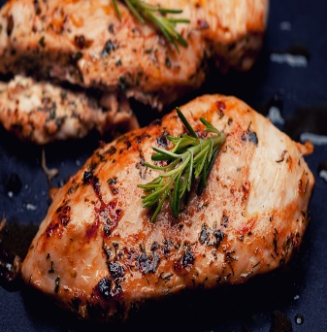
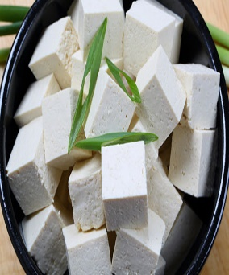
Tip 3: Protein is your anchor: 20 – 30 grams per meal then build around it.
Tip 4: Sleep is a powerful weapon: consume some pre-bed slow digesting protein and stay anabolic for productive recovery repair and growth.

Slide 42
MEAL PLANNING TIPS
Choose a scheduled time in the week when you can plan and prepare your meals for the upcoming week.
When you have a stack of healthy meals in the fridge ready to heat and eat, fuel and recovery nutrition becomes a much easier choice.
You can easily prepare 20 + meals in two hours.

Slide 43
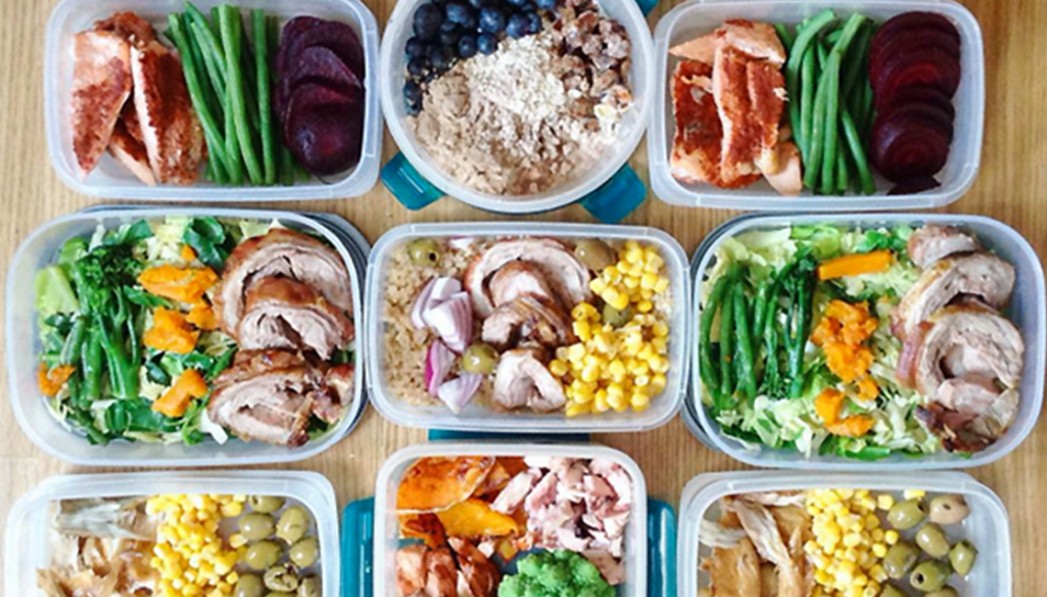
Meal Prep: How to
Pull out the schedule for next week and calculate how many meals you need (breakfast, lunch, dinner, pre training, post training, snacks)
Make a list of the daily servings of each macro nutrient you need.
Add protein shake recovery fuel requirements.
Notes:
Some of my fav meal prep ideas are chicken and rice with vegetables, salmon, sweet potato and broccoli, mixed fruits and nuts

Slide 44
Meal Prep – How to CONT.
4. Shop with your grocery list – stick to the plan
5. Cut all your ingredients and put them into bowls
6. Cook through what needs to be cooked
(meats then vegetables and grains)
7. Mix and match them into your meal
containers.
Notes:
Some of my fav meal prep ideas are chicken and rice with vegetables, salmon, sweet potato and broccoli, mixed fruits and nuts

Slide 45
Eat right 80% of the time & don’t beat yourself up over the other 20%
The 80/20 Rule
Notes:
Remember the 80-20 rule: Eat well at least 80 percent of the time but leave some room for soul nourishment and pure pleasure.
If you're going to ingest foods or drinks that offer little nutritional value -such as coffee, ice cream, chocolate and so on, make the indulgence worthwhile.
If the food offers no nutritional value at least aim to get maximum psychological pleasure out of it. Then get back on track otherwise you will feel sluggish and sorry ☺

Slide 46
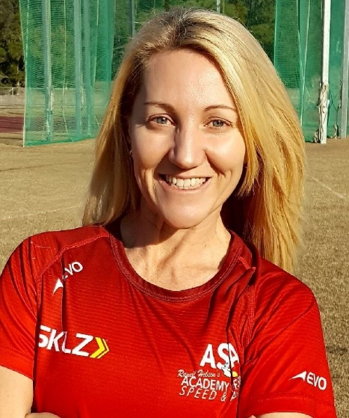
Ranell Hobson
speedyranell@bigpond.com

Slide 47
REFERENCES:
Deakin, V. (2000). Clinical sports nutrition (pp. 457-459). L. Burke, & V. Deakin (Eds.). Beijing, Boston: McGraw-Hill.
Eatforhealth.gov.au
Goldstein, E. R., Ziegenfuss, T., Kalman, D., Kreider, R., Campbell, B., Wilborn, C., ... & Wildman, R. (2010). International society of sports nutrition position stand: caffeine and performance. Journal of the International Society of Sports Nutrition, 7(1), 5.
Kleiner, S. (2014) Power Eating 4th ed.
Mueller, K., & Hingst, J. (2013). The athlete's guide to sports supplements. Human Kinetics.
Thomas, D. T., Erdman, K. A., & Burke, L. M. (2016). American College of Sports Medicine Joint Position Statement. Nutrition and Athletic Performance. Medicine and science in sports and exercise, 48(3), 543-568.
Verstegen, M., & Williams, P. (2014). Every day is game day: The proven system of elite performance to win all day, every day. Avery, a member of Penguin Group (USA).

