Slide 1
ATHLETE RECOVERY
Correct & effective recovery increases adaptations from training

Slide 2
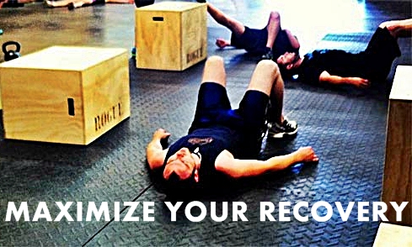
Athlete recovery
Recovery should be aimed at increasing an athletes capacity to manage the physical and mental demands of training and competition.
To insure the highest quality training and to prevent overtraining, recovery must be planned as part of the training process.

Slide 3
Importance of recovery
Building recovery time into any training program is important because this is the time that the body adapts to the stress of exercise and the real training effect takes place.
Recovery also allows the body to replenish energy stores and repair damaged tissues.
Exercise or any other physical work causes changes in the body such as muscle tissue breakdown and the depletion of energy stores (muscle glycogen) as well as fluid loss.

Slide 4
Overtraining
Overtraining frequently occurs in athletes who are training for competition or a specific event and train beyond the body's ability to recover.
Athletes often exercise longer and harder so they can improve. Without adequate rest and recovery, these training regimens can backfire, and actually decrease performance.
Conditioning requires a balance between overload and recovery. Too much overload and/or too little recovery may result in both physical and psychology symptoms of overtraining.

Slide 5
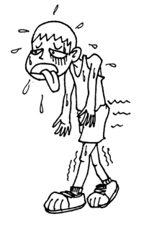
Overtraining signs & symptoms
Washed-out feeling, tired, drained, lack of energy
Mild leg soreness, general aches and pains
Pain in muscles and joints
Sudden drop in performance
Insomnia
Headaches
Decreased immunity (increased number of colds,
and sore throats)
Decrease in training capacity / intensity
Moodiness and irritability
Decreased appetite
Increased incidence of injuries

Slide 6
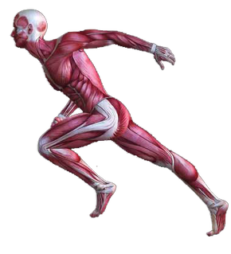
Physiological adaptations
Recovery is when the body reorganises its physical capacities to meet the demands of training.
Skeletal system adaptations
Cardio-vascular system adaptations
Muscular system adaptations

Slide 7
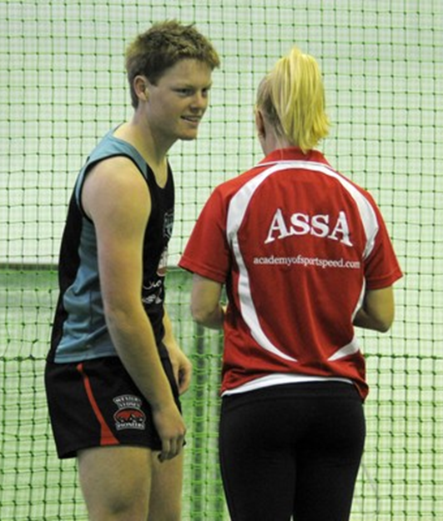
Recovery time frames
Cardiovascular exercise – 8 hrs
Resistance training – 24 to 48 hrs
Plyometrics and power training – 48 to 72 hrs
Sports training ????
Depends on what is involved in the session.
Talk to your athlete, ask the important questions.

Slide 8
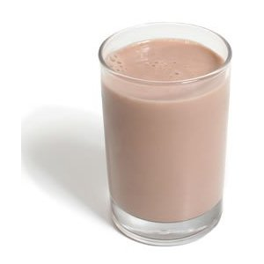
recovery methods
Wayne Goldsmith proposed the acronym WASHUP to remember the recovery techniques.
WATER – different forms of water (ice, contrast showers, swimming pool)
ACTIVE REST – walking, swimming, cycling
SLEEP – ensuring adequate quality & quantity of sleep.
HYDRATION & REFUELING – correct nutrition taking into account both quantity and timing of foods and liquids
UNWIND - Mental and emotional recovery
PHYSICAL THERAPIES – massage, stretching, yoga, physiotherapy, compression gear etc

Slide 9
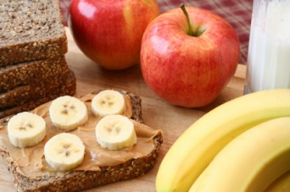
Tips for Nutritional recovery
Before – Top up liver glycogen stores but maintain a level blood glucose level, muscle glycogen provides fuel whereas the blood sugar level controls functioning of the brain and nervous system, hence if blood sugar levels fall reaction time will be adversely affected.
Example – wheat biscuit with bananas, low fat milk, water or diluted juice.

Slide 10
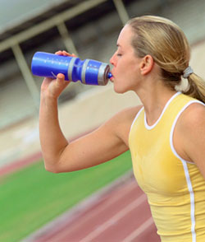
During – lots of water
Depending on length and type of training / game - glucose polymer and amino acid mix
Avoid fats and too much protein as it takes too long to digest.

Slide 11
Post training nutrition
Water for hydration (a good idea is to weigh before and after training), get into the habit of sipping small amounts of water all day, every day.
Carbohydrate – 1 gram of CHO per kg of bodyweight within 15 mins post training
Carbohydrate Plus Protein Speeds Recovery
Research shows that combining protein with carbohydrate within 30 mins of exercise nearly doubles the insulin response, which results in more stored glycogen.
The optimal carbohydrate to protein ratio for this effect is 4:1 (four grams of carbohydrate for every one gram of protein). Eating more protein than that has a negative impact as it slows rehydration and glycogen replenishment.
One study found that athletes who refuelled with carbohydrate and protein had 100% greater muscle glycogen stores than those who only ate carbohydrate. Insulin was also highest in those who consumed a carbohydrate and protein drink.

Slide 12
Chocolate Milk
A new study, published in the International Journal of Sport Nutrition and Exercise Metabolism, reports that athletes who drank chocolate milk after an intense bout of exercise were able to workout longer and with more power during a second workout compared to athletes who drank commercial sports beverages.
“Our study indicates that chocolate milk is a strong alternative to other commercial sports drinks in helping athletes recover from strenuous, energy-depleting exercise,” according to co-author Joel M. Stager, PhD, professor of kinesiology at Indiana University. “Chocolate milk contains an optimal carbohydrate to protein ratio, which is critical for helping refuel tired muscles after strenuous exercise and can enable athletes to exercise at a high intensity during subsequent workouts.”

Slide 13
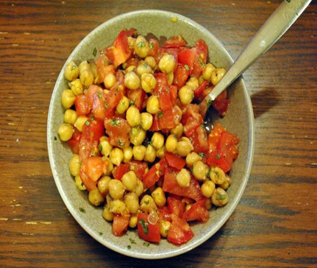
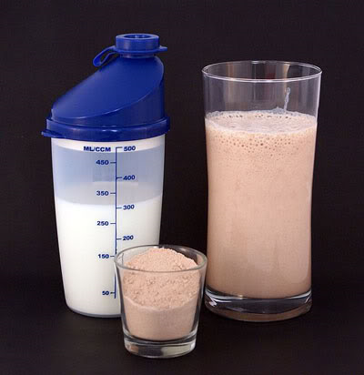
Importance of protein
Protein provides the amino acids necessary to rebuild muscle tissue that is damaged during intense, prolonged exercise.
It can also increase the absorption of water from the intestines and improve muscle hydration.
The amino acids in protein can also stimulate the immune system, making you more resistant to colds and other infections.

Slide 14
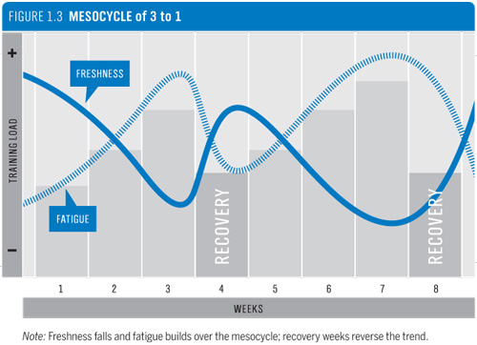
Purpose of recovery
Its purpose is to accelerate an athlete’s capacity to adapt to the physical and mental demands of their training and competition schedule……faster recovery means an athlete can work harder more often.

Slide 15
recovery plan
Physical
Nutritional
Conduct an effective cool down including a decent amount of stretching and foam rolling
Put on compression gear
Sleep in a dark room without electronic stimulation for 90 mins before sleep time
Protein / CHO mix 4:1 within 20 mins
All meals should be CHO / Protein mix
Essential fatty acids (omega 3) to decrease inflammation

